Slide 1
Body Fat Assignment
Stat 628 Module 2
RUI HUANG
CHENYANG JIANG
HanGyu KANG
ENZE WANG

Slide 2
Body Fat Assignment
Introduction
Data Analysis and Data Clean
Variables Selection
Models Selection
Model Diagnosis and Summary
Shiny Application
Acknowledge

Slide 3
Introduction
Body Fat Percentage = total mass of fat / total body mass.
A precise way to measure body fat is to combine submersion method with Siri equation (Body fat=495/Density-450). But it is difficult.
Our group want to figure out a convenient way to predict body fat.

Slide 4
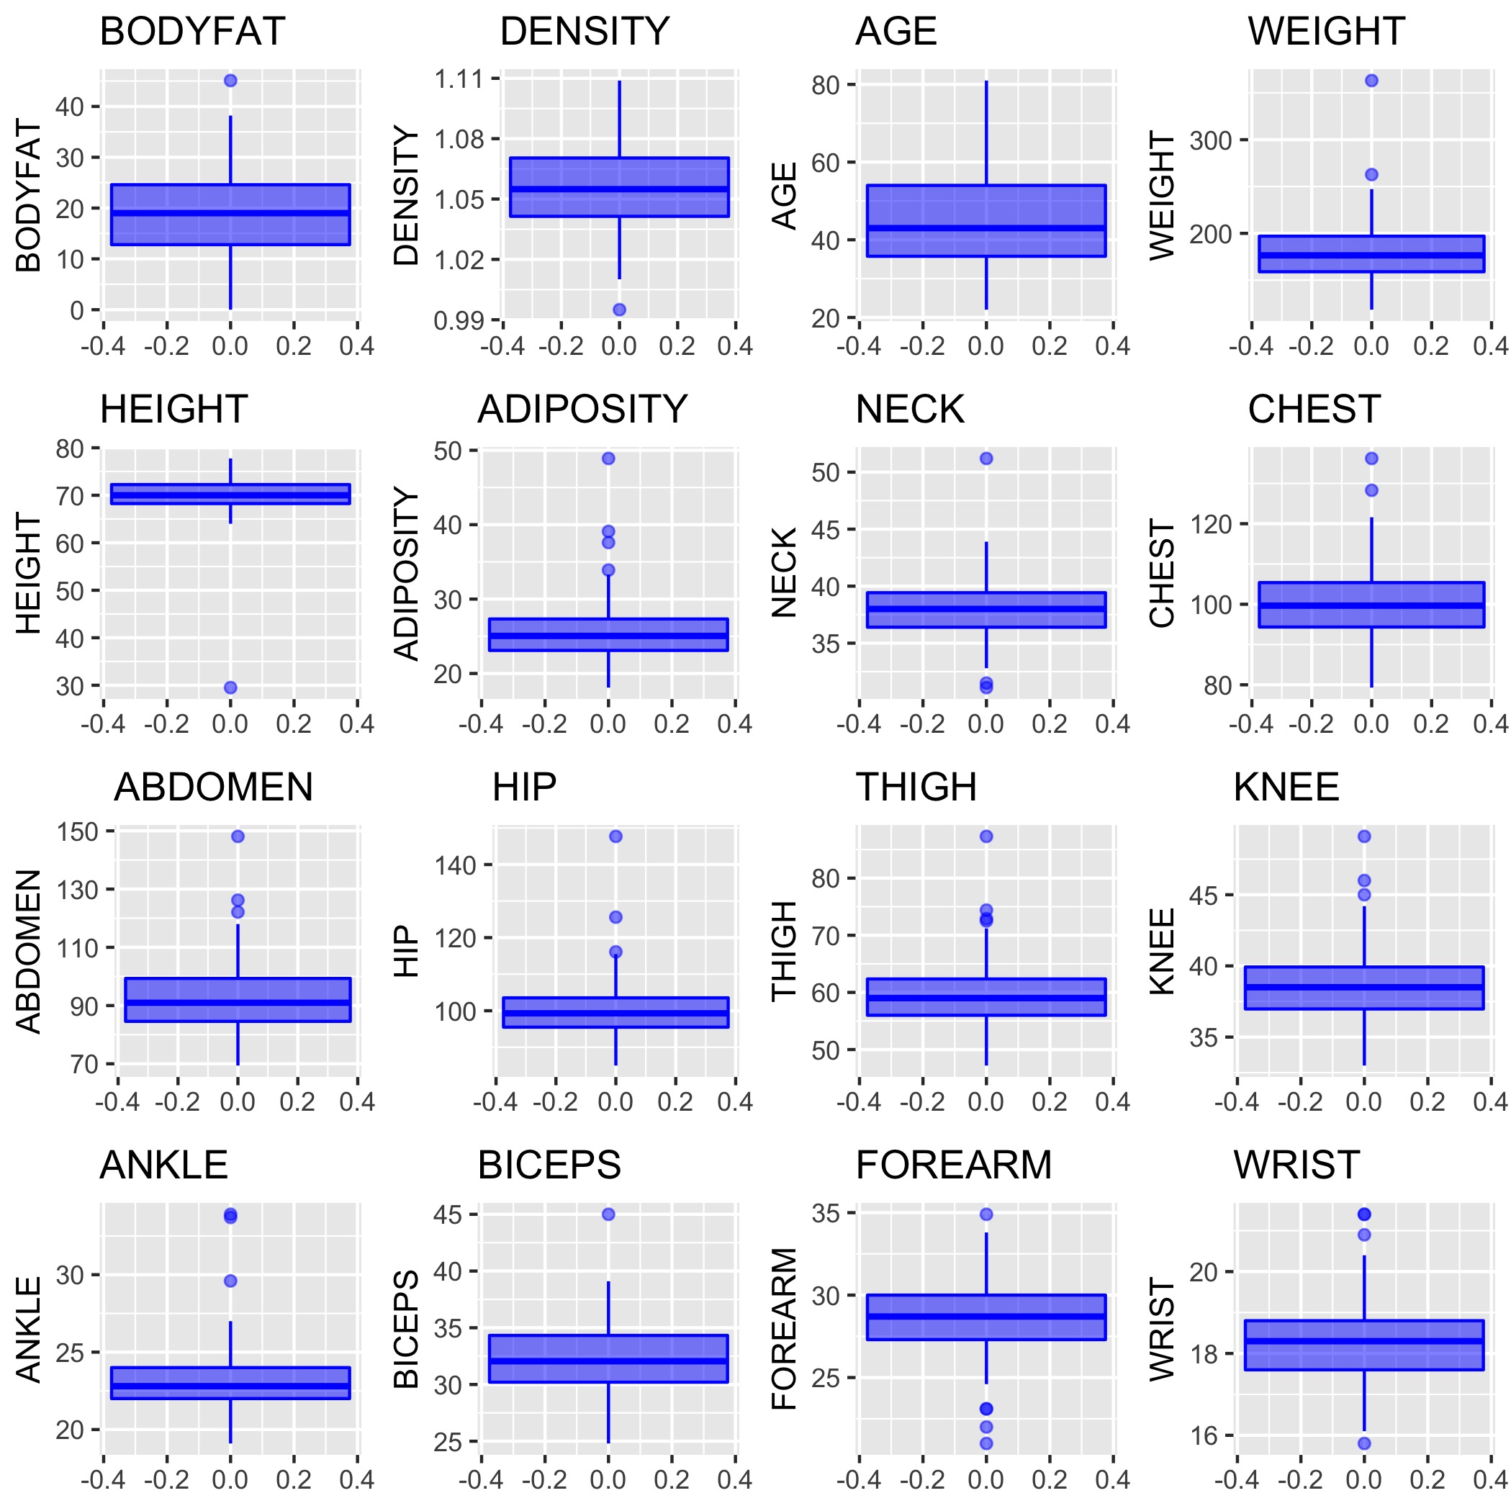
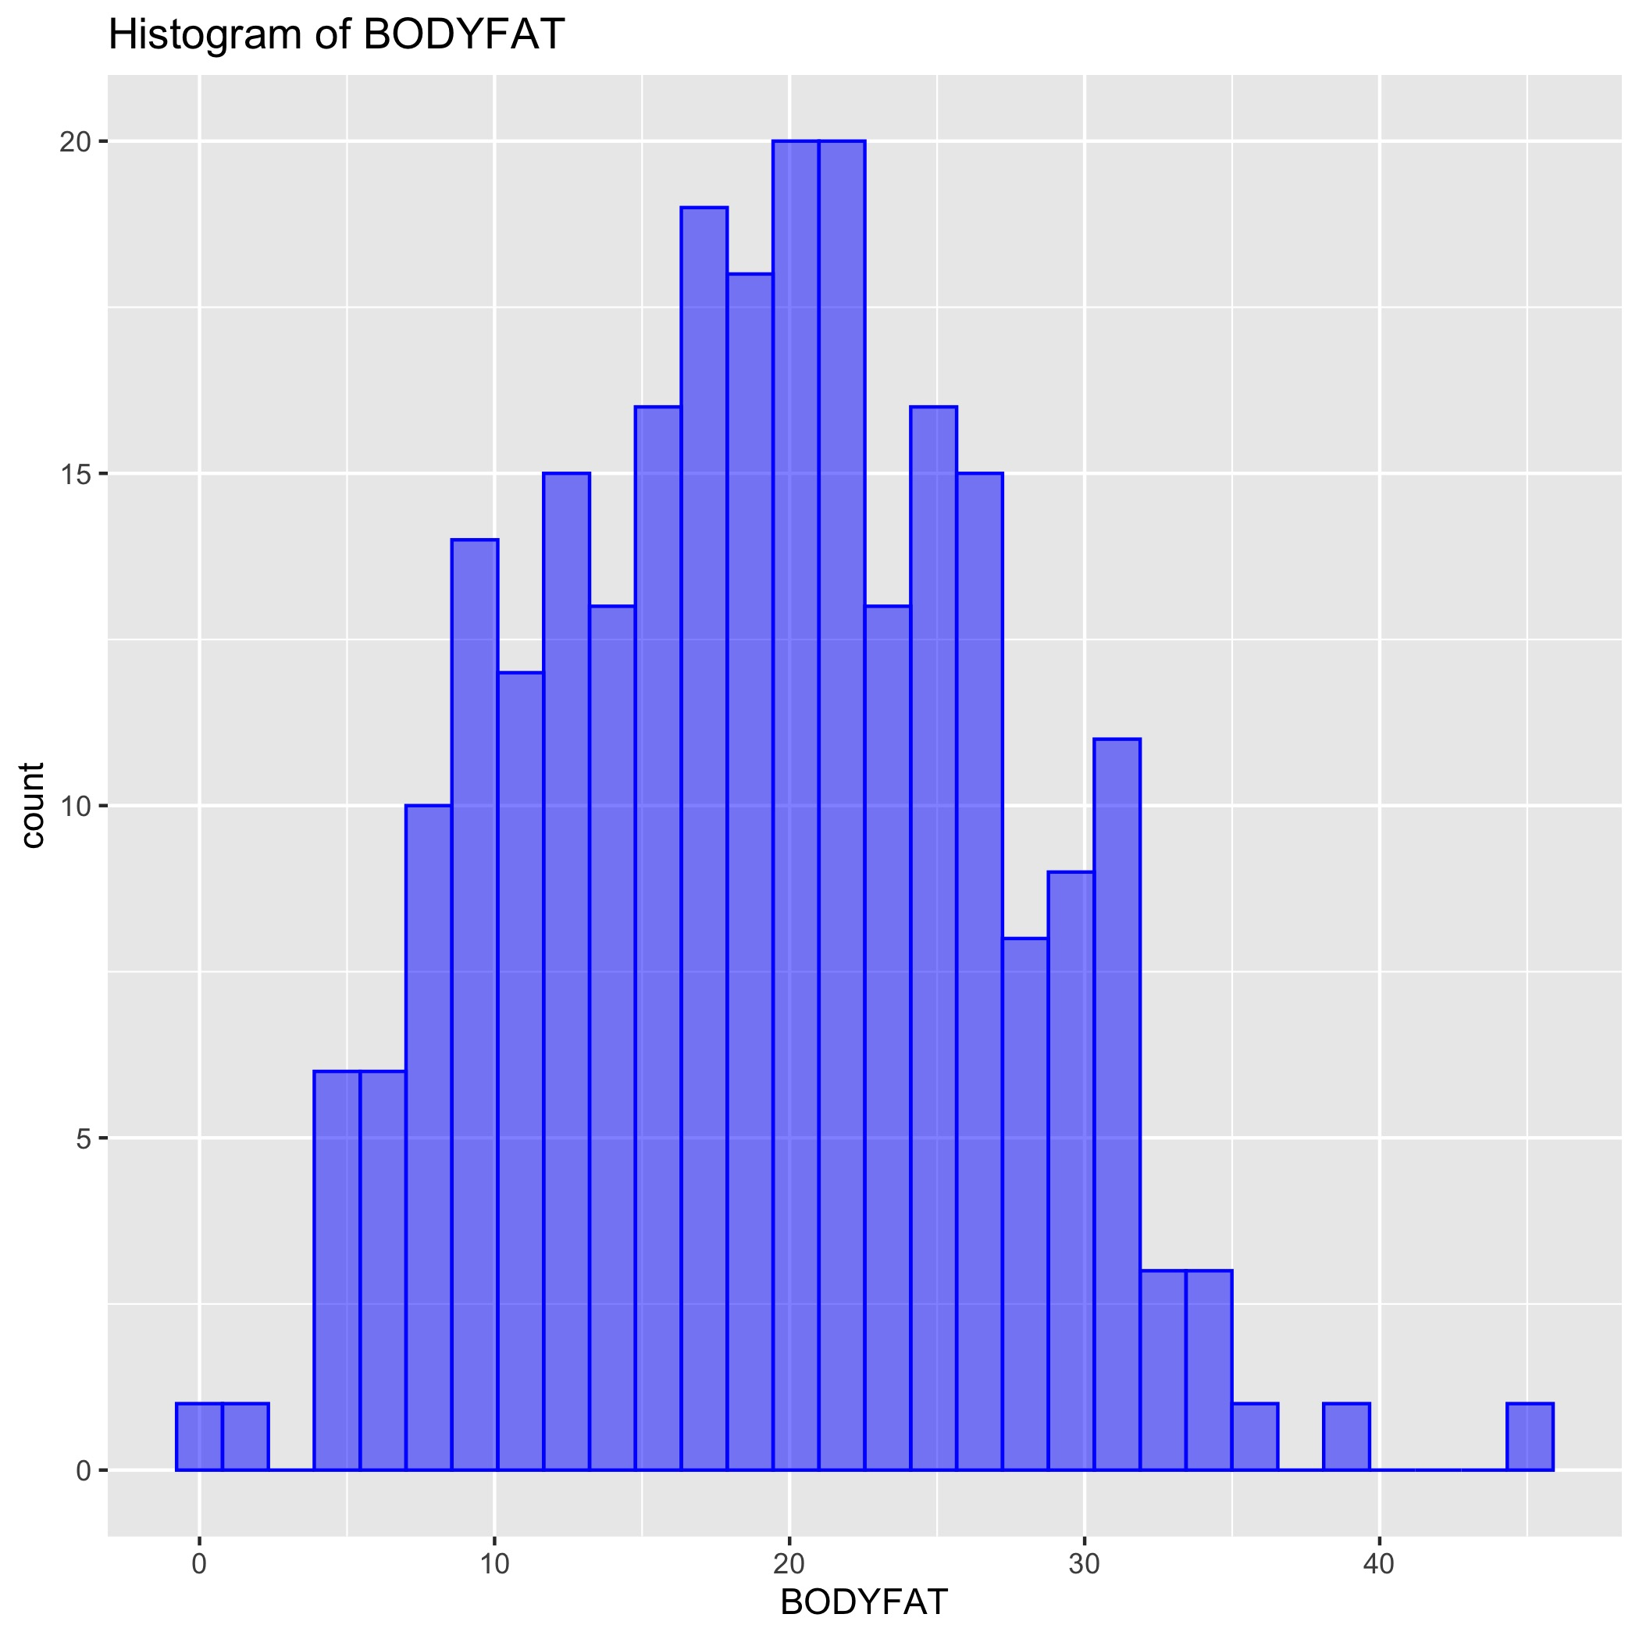
Data Analysis
252 observations and 16 valid variables.
Study data distribution and range.
Find any outliers.
Find any null and abnormal value

Slide 5
Data Clean - Boxplots
Outstanding outliers:
IDNO | Reason | Method
182 | BODYFAT is 0 | Remove
216 | Extreme value in BODYFAT | Remove
39 | Outliers from boxplots | Remove
42 | Low HEIGHT | Fix by BMI equation, update HEIGHT by 69 inches
41 | Outliers from boxplots | Remove

Slide 6
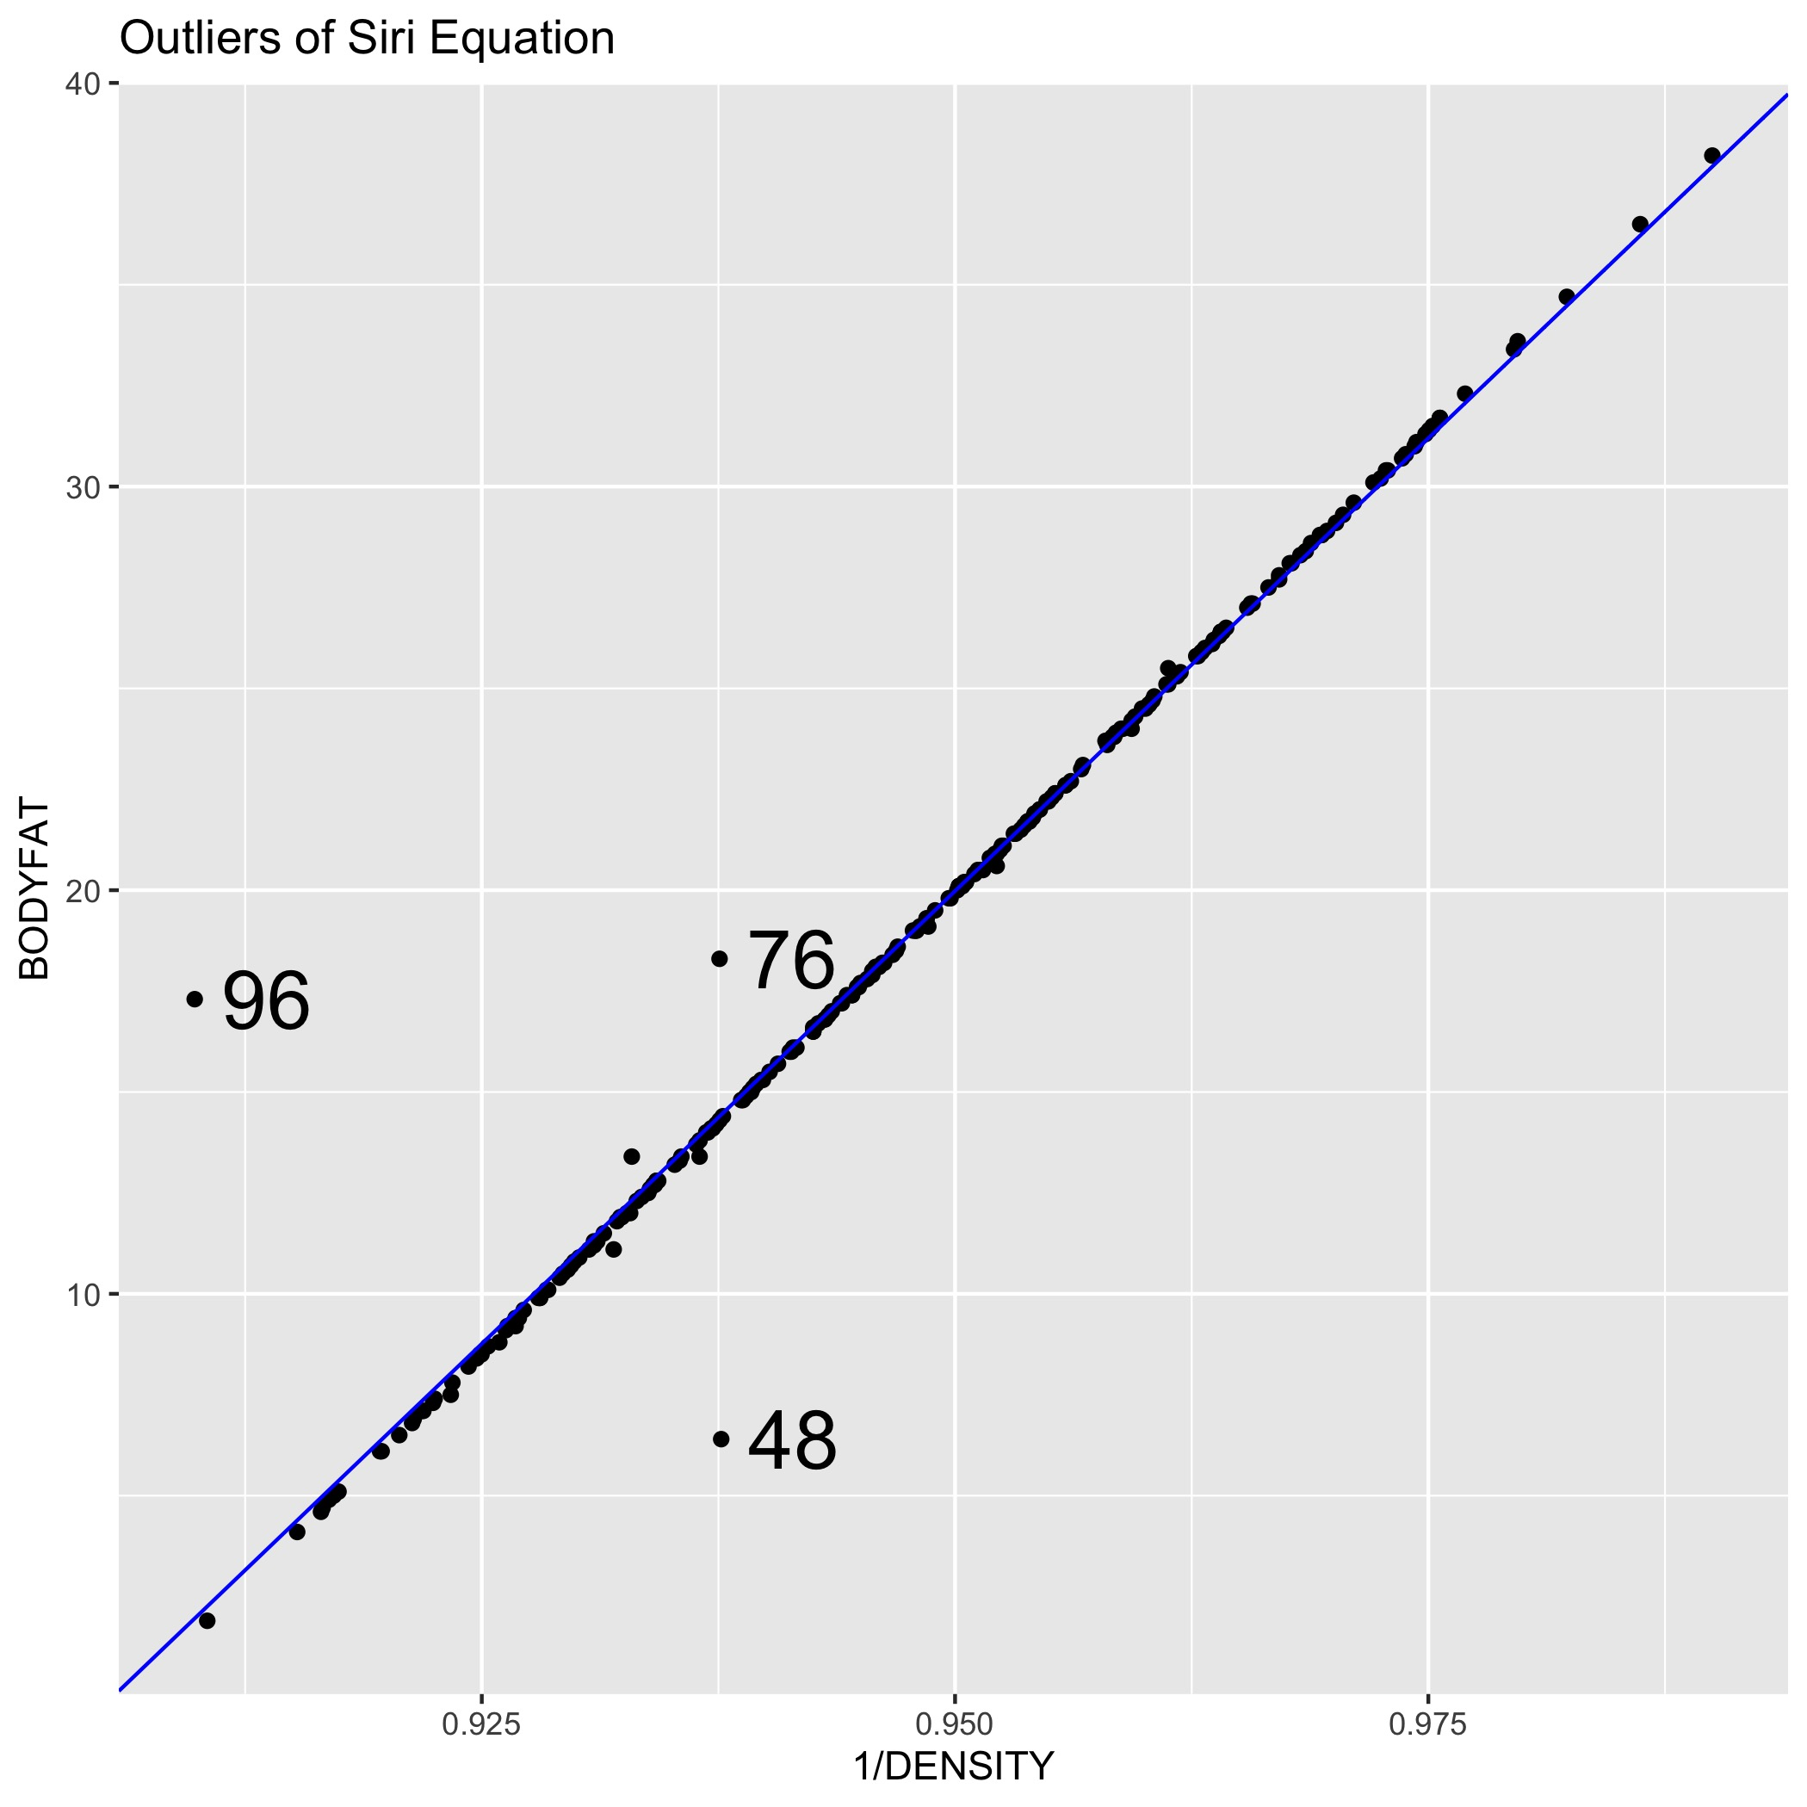
Data Clean – Siri Equation
Connection between BODYFAT and DENSITY in our data is called Siri equation.
Siri equation: BODYFAT=495/DENSITY-450.
Outstanding outliers in regression between BODYFAT and 1/DENSITY.
IDNO | Initial BODYFAT | New BODYFAT | Method
96 | 17.3 | 0.36 | Keep initial BODYFAT
76 | 18.3 | 14.09 | Update BODYFAT
48 | 6.4 | 14.13 | Update BODYFAT

Slide 7
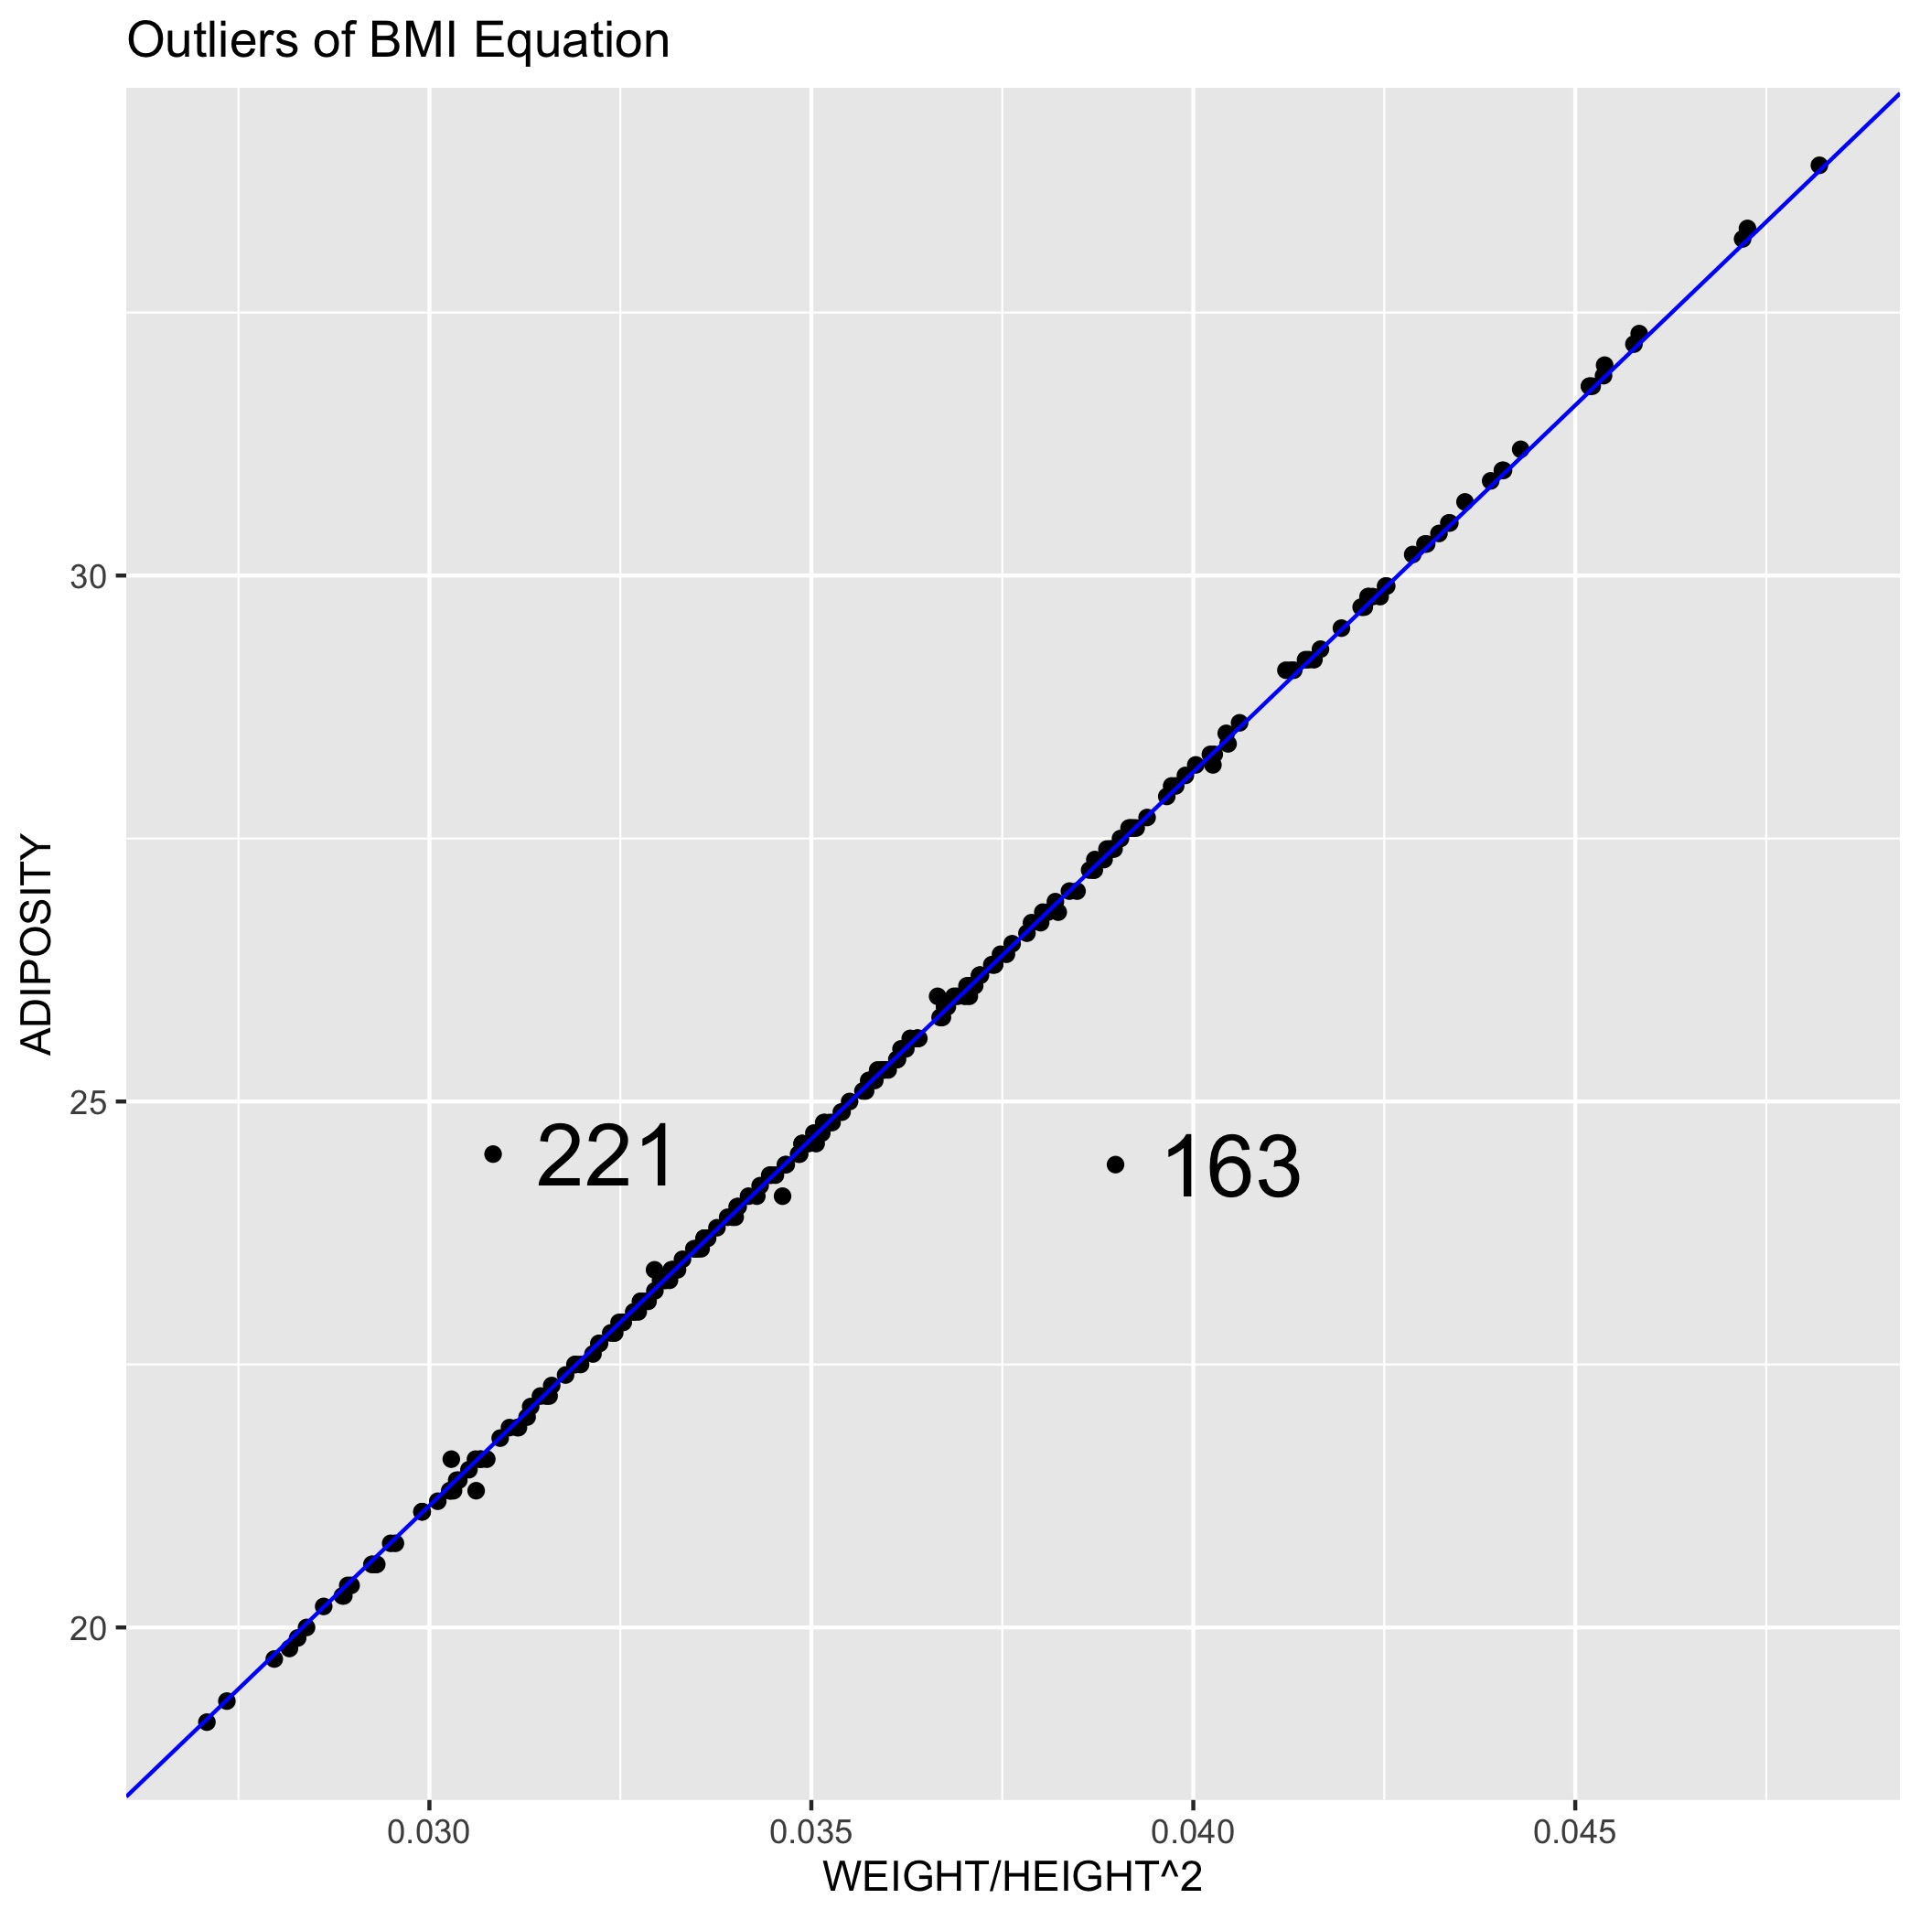
Data Clean – BMI Equation
Connection among ADIPOSITY, WEIGHT and HEIGHT in our data is called BMI equation:
BMI equation: ADIPOSITY=703 WEIGHT/HEIGHT²
Outstanding outliers in regression between ADIPOSITY and WEIGHT/HEIGHT²
IDNO | Initial ADIPOSITY | New ADIPOSITY | Method
163 | 24.4 | 27.4 | Update new ADIPOSITY
221 | 24.5 | 21.7 | Update new ADIPOSITY

Slide 8
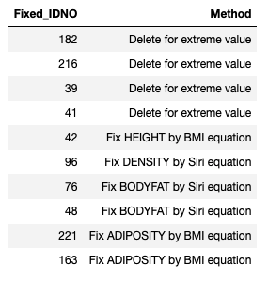
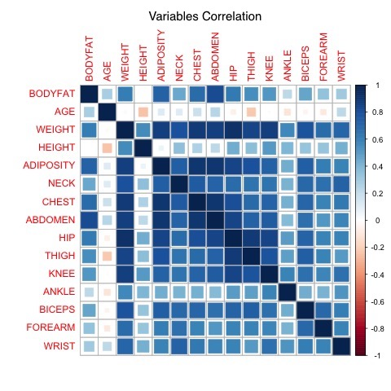
Clean Data - Summary
Table of how we deal with outliers:
It is a trade off to keep or remove outliers.
The final dataset contains 248 observations. There is high correlation among variables after clean in heat plot of correlation:

Slide 9
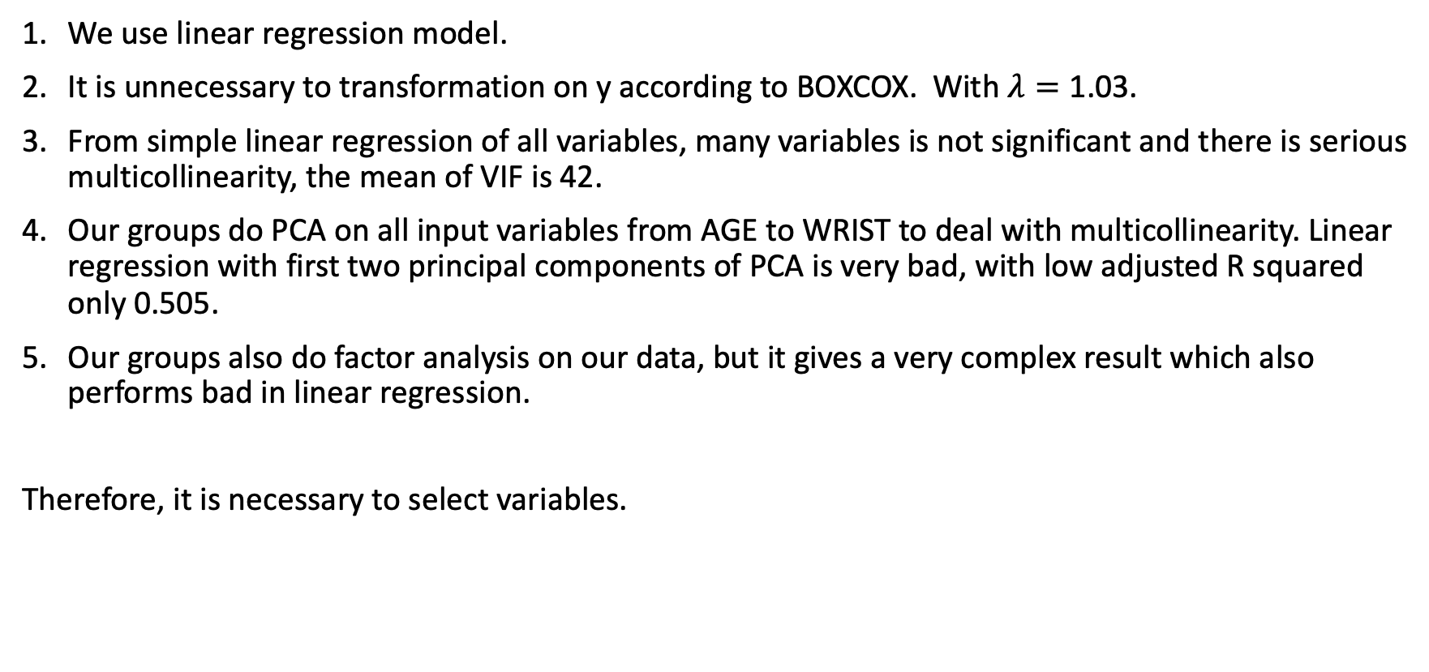
Variables Selection – Model Build
We use linear regression model.
It is unnecessary to transformation on y according to BOXCOX. With $λ=\text{1.03}$.
From simple linear regression of all variables, many variables is not significant and there is serious multicollinearity, the mean of VIF is 42.
Our groups do PCA on all input variables from AGE to WRIST to deal with multicollinearity. Linear regression with first two principal components of PCA is very bad, with low adjusted R squared only 0.505.
Our groups also do factor analysis on our data, but it gives a very complex result which also performs bad in linear regression.
Therefore, it is necessary to select variables.

Slide 10
Variables Selection – Basic Idea
Method:
Lasso Regression
Subsets Method with Cp and BIC
Forward Direction Search with AIC and BIC
We prefer both simple and precise model.
Full Model:
Four full model:
Full model with all variables: BODYFAT~AGE+WEIGHT+HEIGHT+ADIPOSITY+NECK+CHEST+ABDOMEN+HIP+THIGH+KNEE+ANKLE+BICEPS+FOREARM+WRIST
Full model with all variables after logarithmic (log()) transformation, from LogAGE to LogWRIST
Full model with all variables after square (^2) transformation, from sqAGE to sqWRIST
Full model with all variables from 1, 2, 3, with AGE, LogAGE, sqAGE and others.
We still want to figure out any improvement after transformation on x

Slide 11
Variables Selection – Lasso Regression
Lasso regression adds a Lasso penalty to loss function and works both on variable selection and prediction accuracy.
Results: BODYFAT ~ AGE + HEIGHT + NECK + ABDOMEN + BICEPS + FOREARM + WRIST + THIGH with adjusted R squared is 0.7197
The multicollinearity of linear regression with variables above is not so serious, the mean of VIF is 2.88. Here is VIF of all variables:
 | AGE | HEIGHT | NECK | ABDOMEN | BICEPS | FOREARM | WRIST | THIGH
VIF | 2.0247 | 1.4289 | 3.3396 | 3.8798 | 3.1619 | 2.2896 | 2.7124 | 4.2167

Slide 12
Variables Selection – Subsets Method
Here we only give results of full model 4 with all variables including square and log transformation.
BODYFAT~ABDOMEN R squared = 0.66
BODYFAT~ABDOMEN + sqWEIGHT R squared = 0.71
BODYFAT~LogWRIST + sqHEIGHT + LogABDOMEN R squared = 0.72
From subsets method results of four full models, the ABDOMEN and its transformation is the most important variable. WEIGHT, WRIST are also very important.

Slide 13
Variables Selection – Forward Direction Search
Here we only give results from BIC:
BODYFAT ~ ABDOMEN + WEIGHT + WRIST BIC=700.41
BODYFAT ~ LogABDOMEN + LogWRIST + LogHEIGHT BIC=697.82
BODYFAT ~ sqABDOMEN + sqWEIGHT + sqWRIST BIC=705.87
BODYFAT ~ ABDOMEN + sqWEIGHT + LogWRIST BIC=697.68
BIC will give simpler models than AIC.
ABDOMEN and its transformation is also the most important variable, followed by WEIGHT and WRIST.

Slide 14
Variables Selection – Summary
12 alternative models:
BODYFAT ~ ABDOMEN + sqWEIGHT + LogWRIST
BODYFAT ~ LogWRIST + sqHEIGHT + LogABDOMEN
BODYFAT ~ ABDOMEN + sqWEIGHT
BODYFAT ~ sqABDOMEN + sqWEIGHT + sqWRIST
BODYFAT ~ sqABDOMEN + sqWEIGHT
BODYFAT ~ sqABDOMEN
BODYFAT ~ LogABDOMEN + LogWRIST + LogHEIGHT
BODYFAT ~ LogABDOMEN + LogWRIST
BODYFAT ~ LogABDOMEN
BODYFAT ~ ABDOMEN + WEIGHT + WRIST
BODYFAT ~ ABDOMEN + WEIGHT
BODYFAT ~ ABDOMEN

Slide 15
Model Selection 30 - Repeated with 10 - fold Cross Validation The root mean squared error and R-squared of 11 models:
ID | Model | Root Mean Squared Error | R-squared
1 | BODYFAT ~ ABDOMEN + sqWEIGHT + LogWRIST | 3.937862 | 0.7247008
2 | BODYFAT ~ LogWRIST + sqHEIGHT + LogABDOMEN | 3.941071 | 0.7226578
3 | BODYFAT ~ ABDOMEN + sqWEIGHT | 4.001342 | 0.7149690
4 | BODYFAT ~ sqABDOMEN + sqWEIGHT + sqWRIST | 4.000357 | 0.7161659
5 | BODYFAT ~ sqABDOMEN + sqWEIGHT | 4.040667 | 0.7083916
6 | BODYFAT ~ sqABDOMEN | 4.322792 | 0.6614911
7 | BODYFAT ~ LogABDOMEN + LogWRIST + LogHEIGHT | 3.945733 | 0.7225947
8 | BODYFAT ~ LogABDOMEN + LogWRIST | 4.030833 | 0.7094928
9 | BODYFAT ~ LogABDOMEN | 4.287261 | 0.6685336
10 | BODYFAT ~ ABDOMEN + WEIGHT + WRIST | 3.965277 | 0.7230111
11 | BODYFAT ~ ABDOMEN + WEIGHT | 4.024765 | 0.7136045
12 | BODYFAT ~ ABDOMEN | 4.289724 | 0.6674128

Slide 16
Model Diagnosis and Summary
We choose ABDOMEN, WEIGHT as our predictors.
Final model
BODYFAT(%)=0.89 ABDOMEN-0.12 WEIGHT-42.4.
Rule of thumb: BODYFAT(%)=abdomen circumference(cm)*0.89 minus weight(lbs)*0.12 minus 42.4.
Adjusted R squared is 0.7029.
Residual standard error is 4.03.
All variables are significant.
No serious multicollinearity, mean VIF=4.0.
Example: Man with 154 lbs WEIGHT and 85 cm ABDOMEN, his BODYFAT will be 15(%).
Coefficients | Estimate | Std Error | P-value | 95% CI Lwr | 95% CI Upr
Intercept | -42.39 | 2.54 | < 2e-16 | -47.399 | -37.383
ABDOMEN | 0.89 | 0.053 | < 2e-16 | 0.789 | 0.997
WEIGHT | -0.12 | 0.019 | 5e-09 | -0.158 | -0.0802

Slide 17
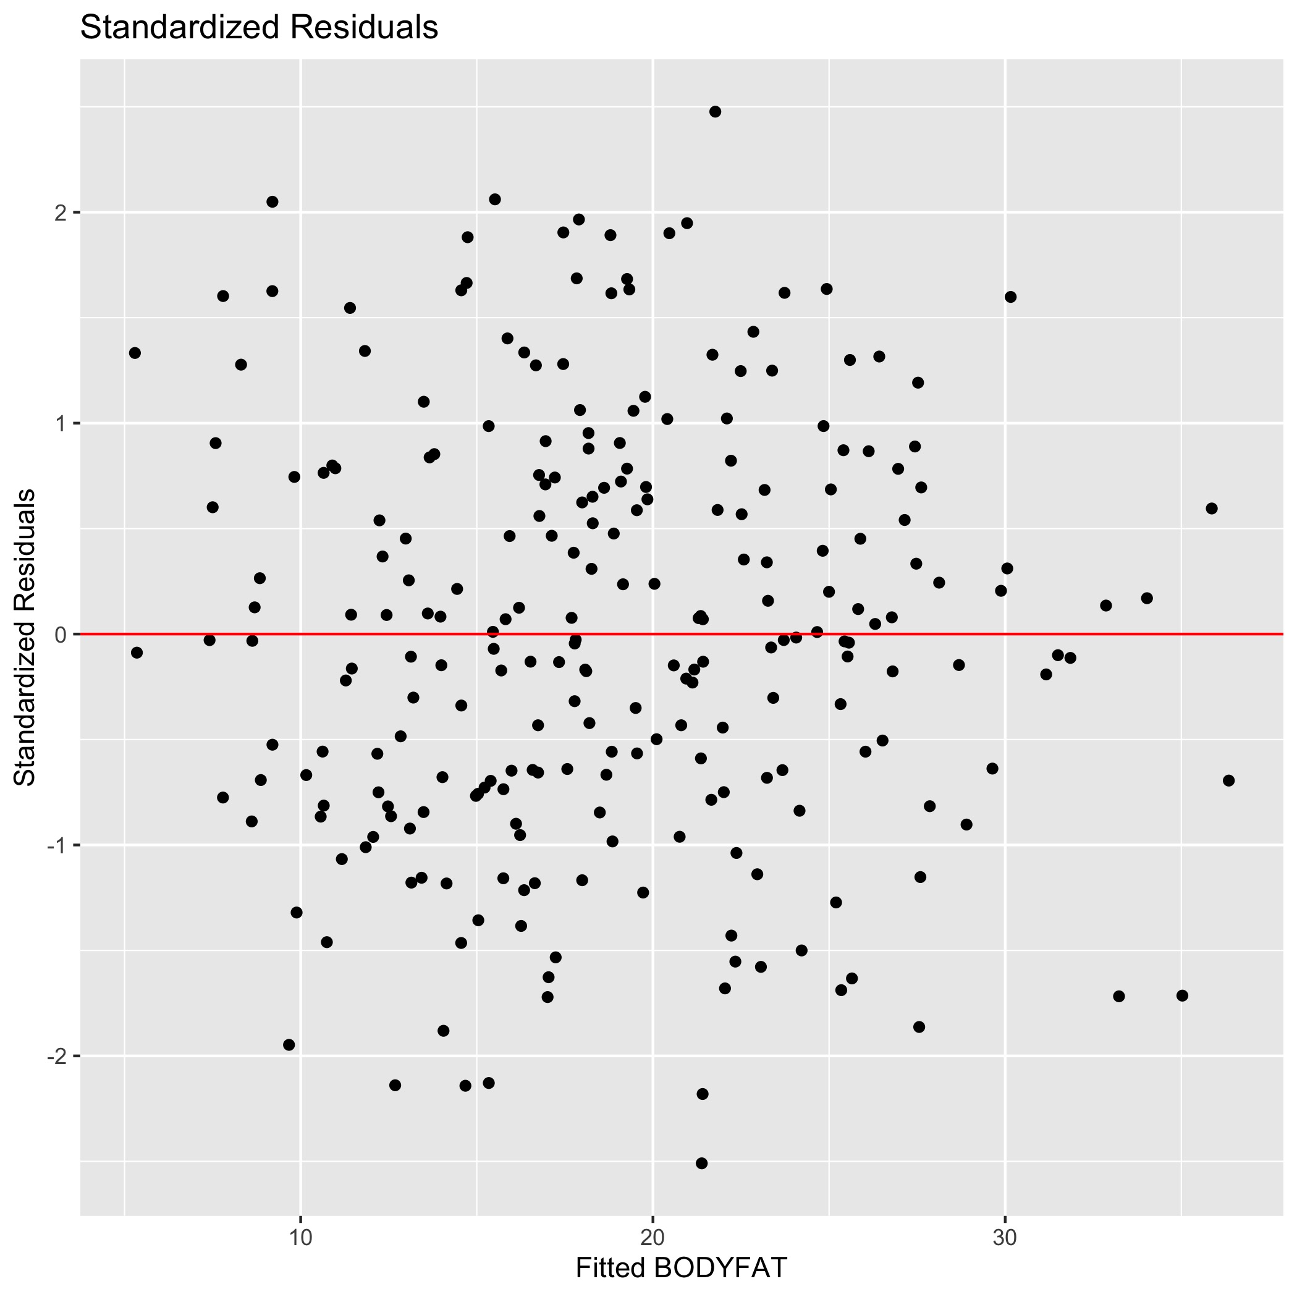
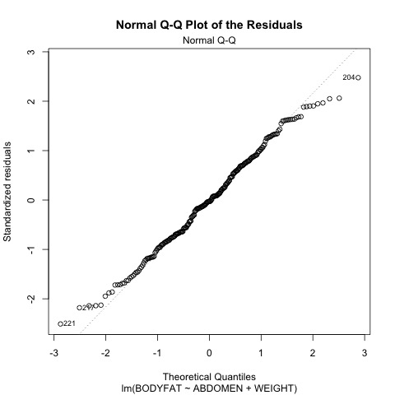
Model Diagnosis – Standardized Residuals, QQ plots for Residuals

Slide 18
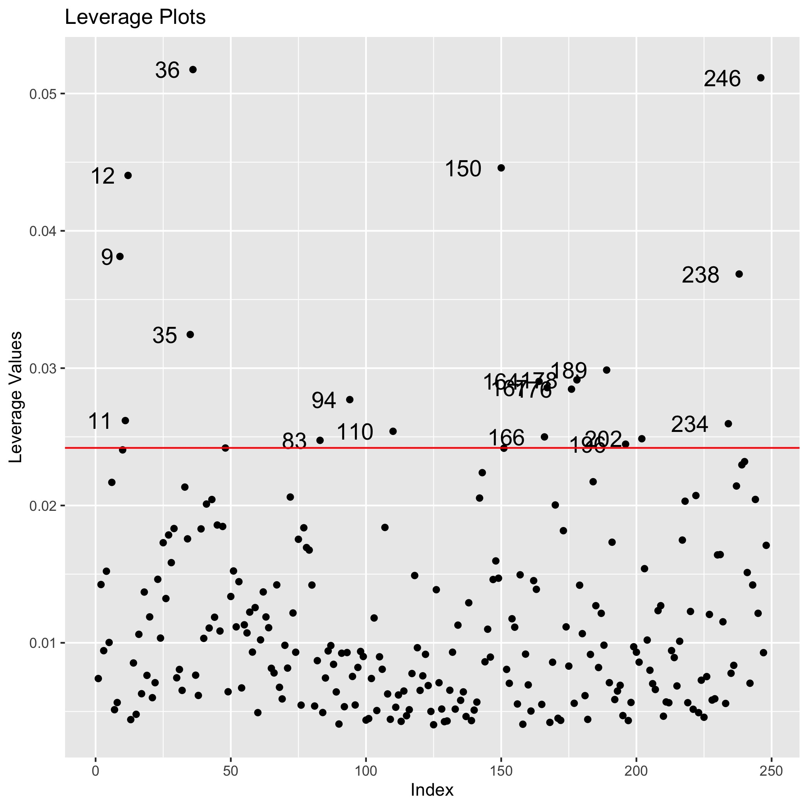
Model Diagnosis – Leverage Plots
The leverage is diagonal elements from 𝐻=𝑋(𝑋′𝑋)⁻¹𝑋′
There is a lot of outliers in Leverage plots.
But the coefficients of model change little after removing the outliers and fitting again.
The new model without outliers is BODYFAT(%)=0.88 ABDOMEN-0.11 WEIGHT-43.14
So we keep the initial model .

Slide 19
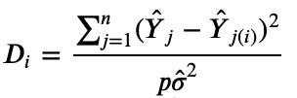
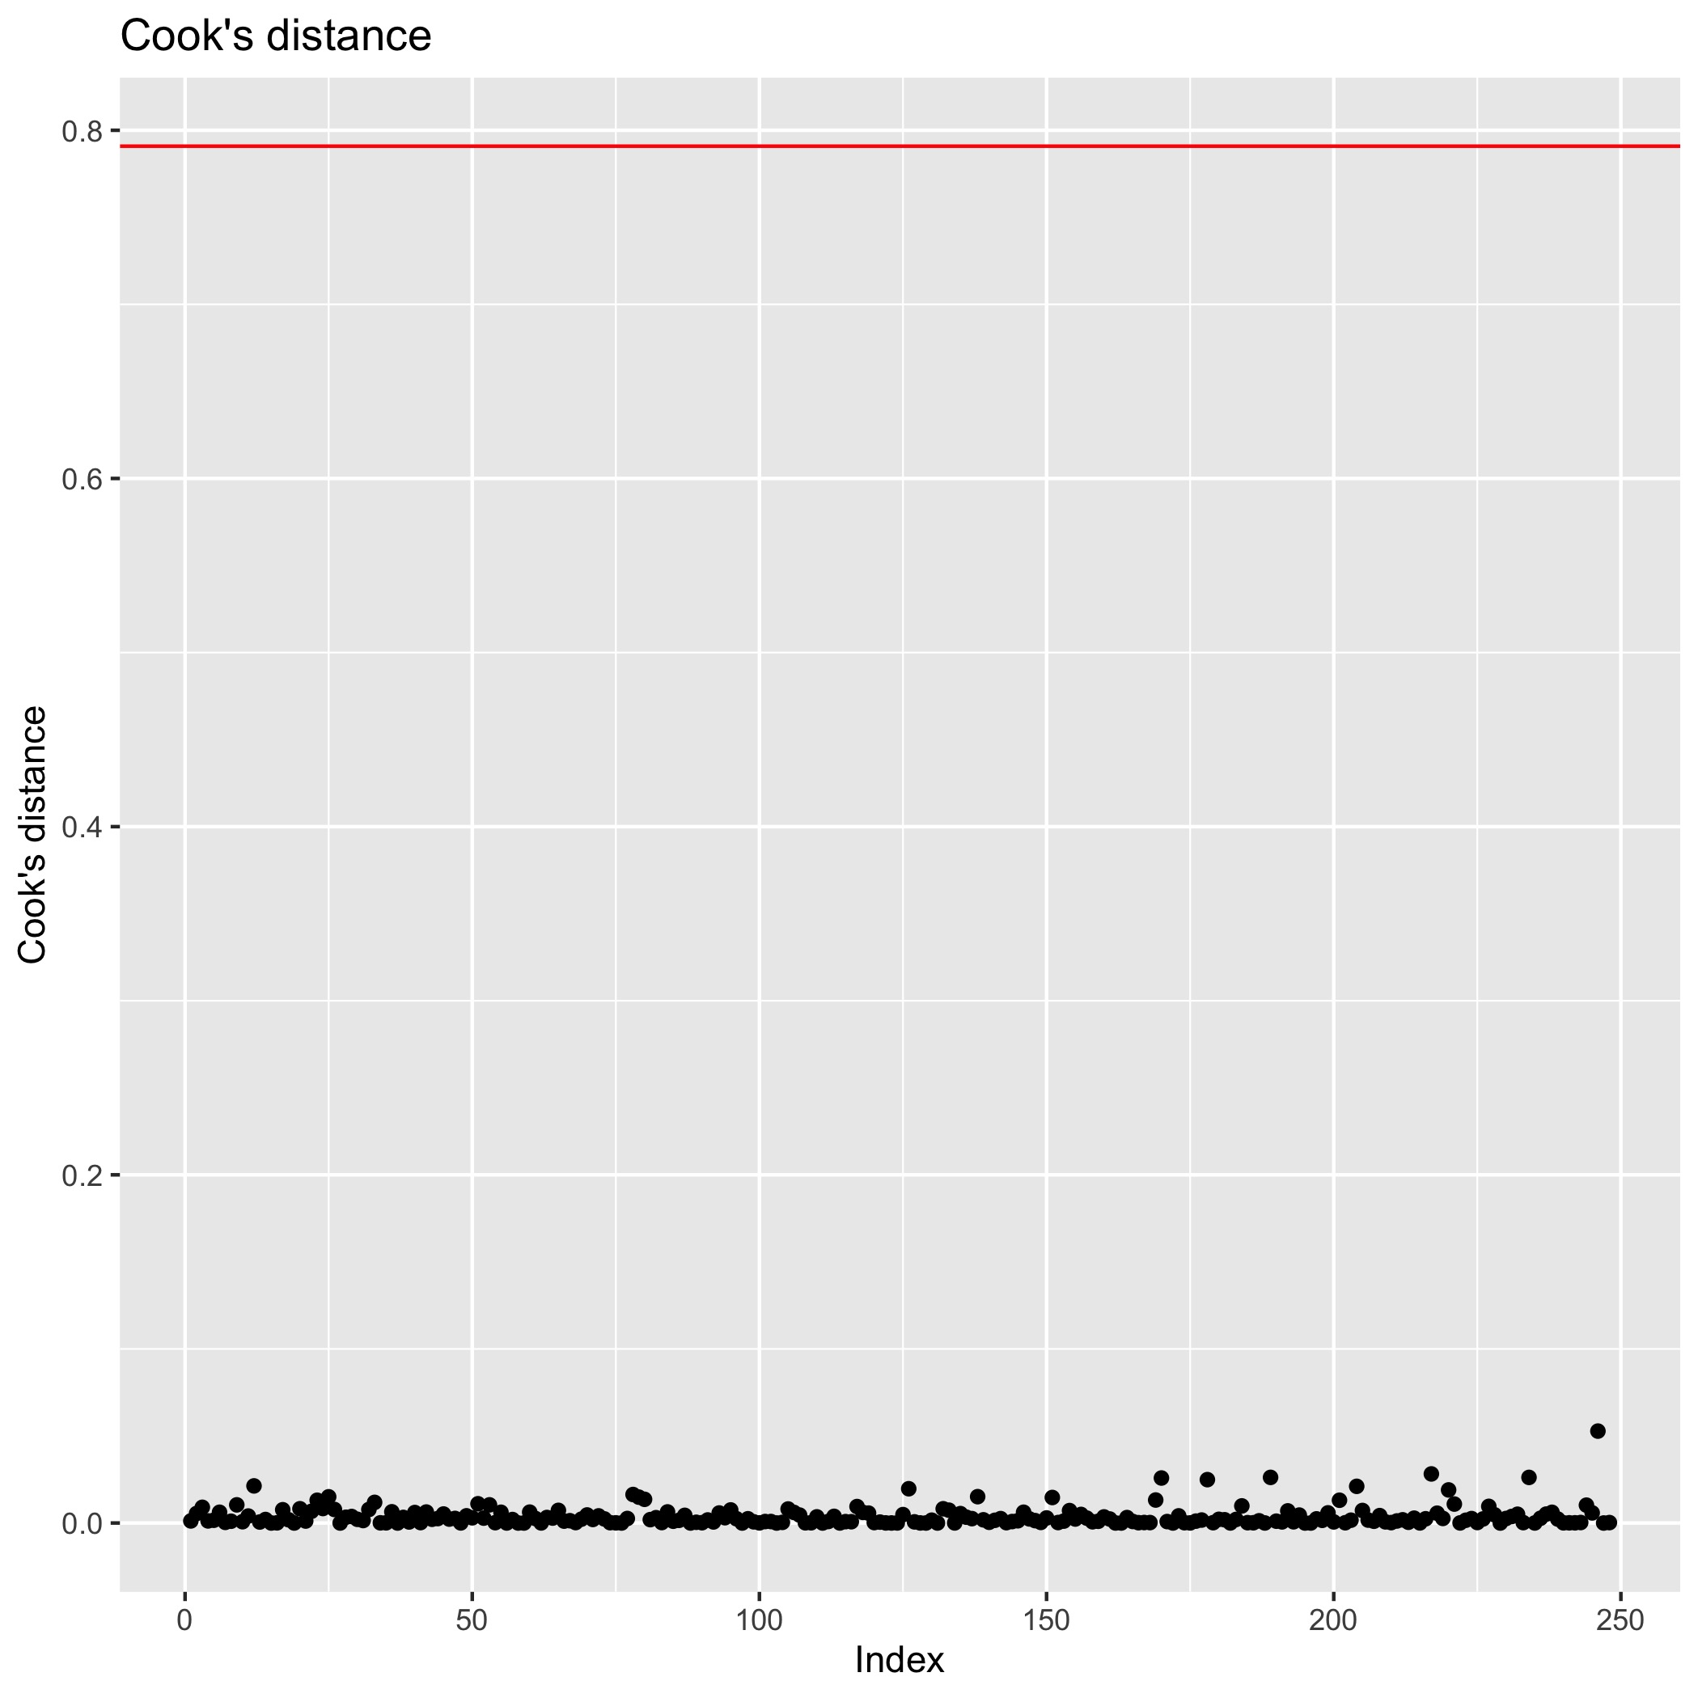
Model Diagnosis – Cook’s Distance
Cook’s distance
measure the influence of i^{th} observation on all n fitted values.
The red line is rule of influential observation.
There is no influential observation in Cook’s Distance.

Slide 20
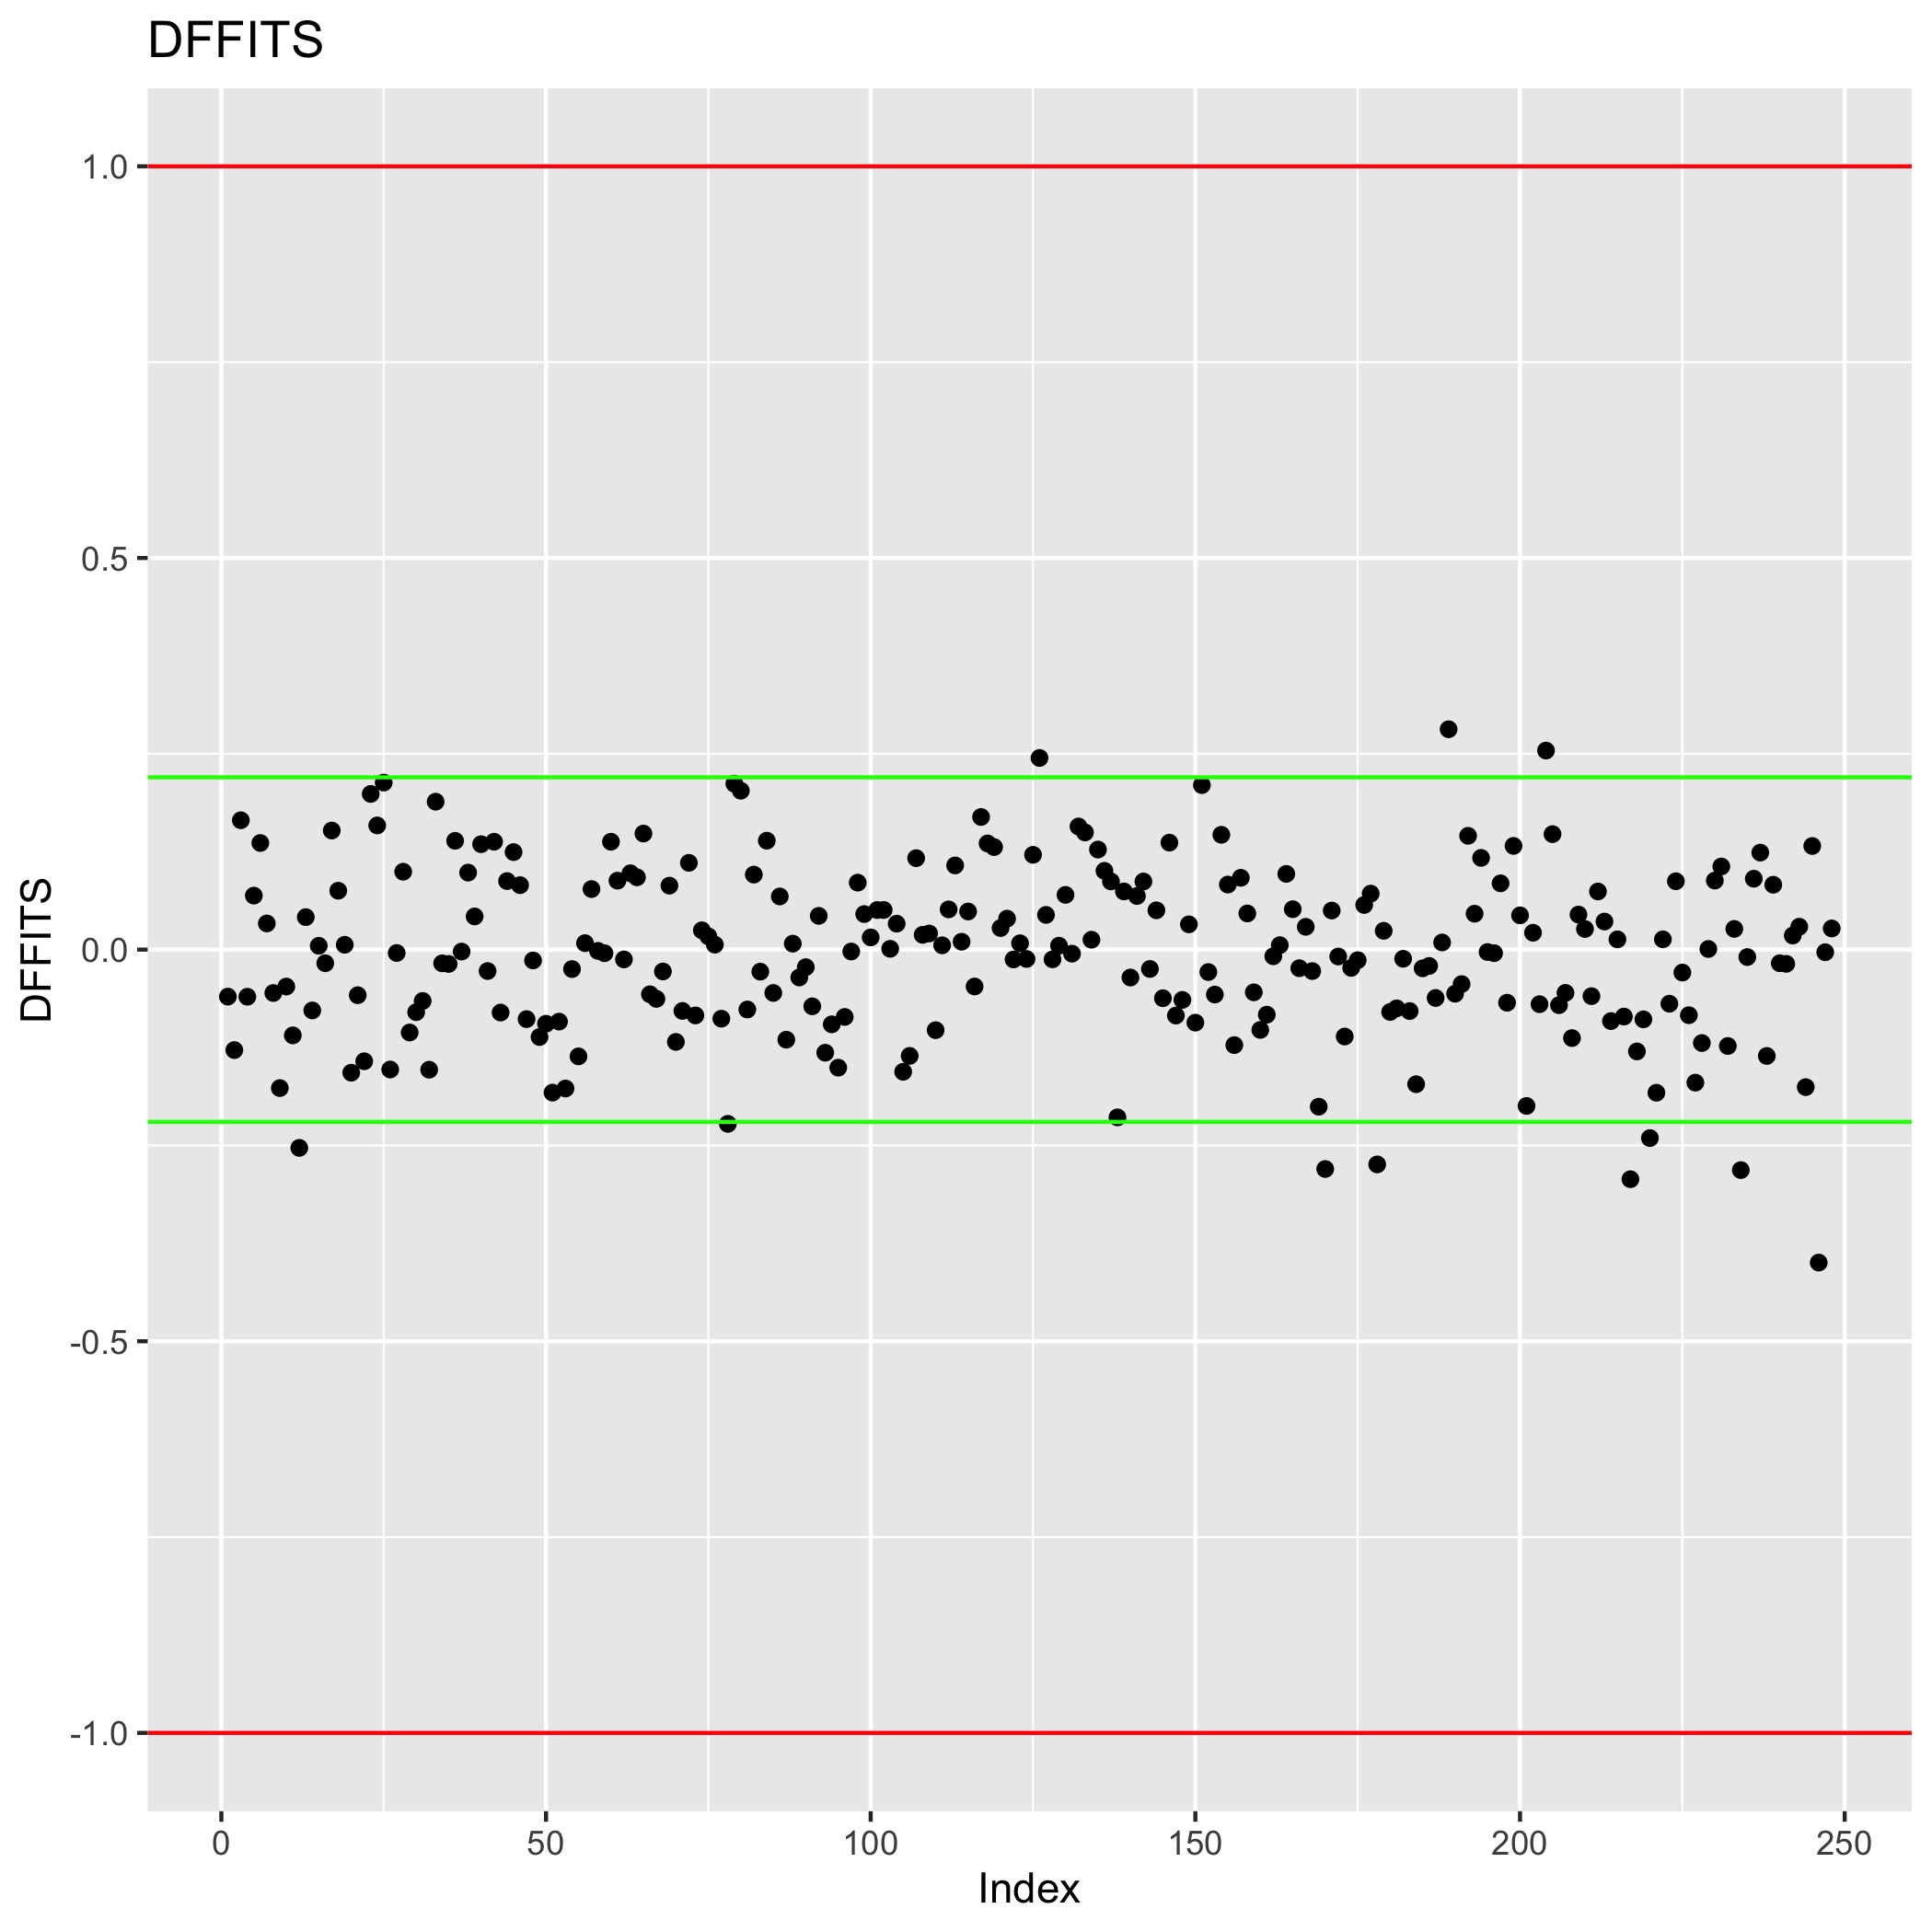
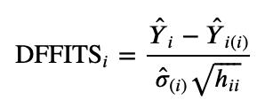
Model Diagnosis - DFFITS
DFFITS
measures the influence of the i^{th} observation on the fitted value y_{i}.
The rule of influential observation for small dataset is red lines, for large dataset is green lines.
There is no obvious influential observation outliers in DFFITS.

Slide 21
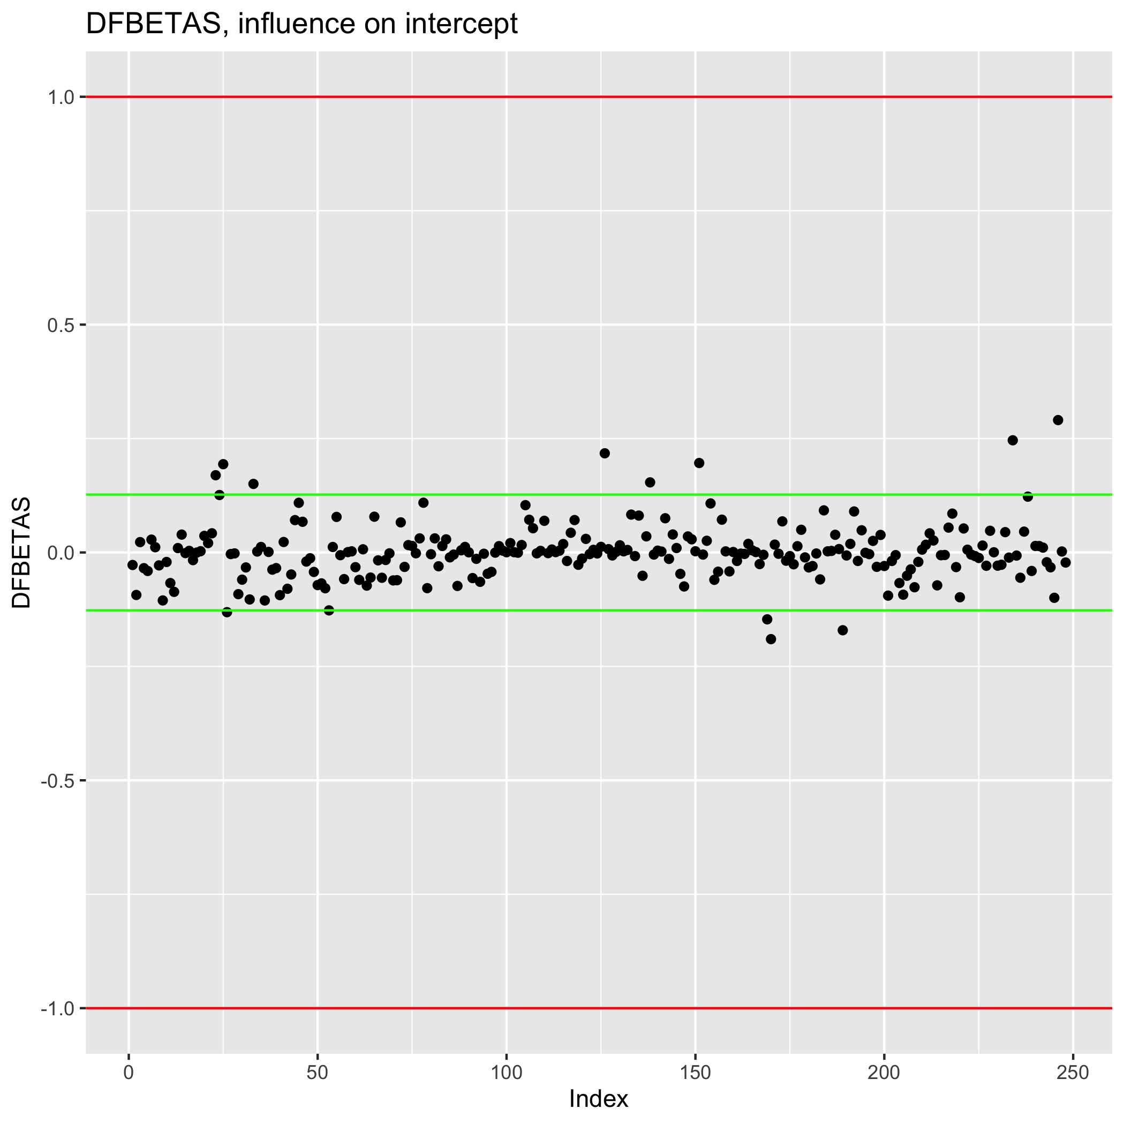
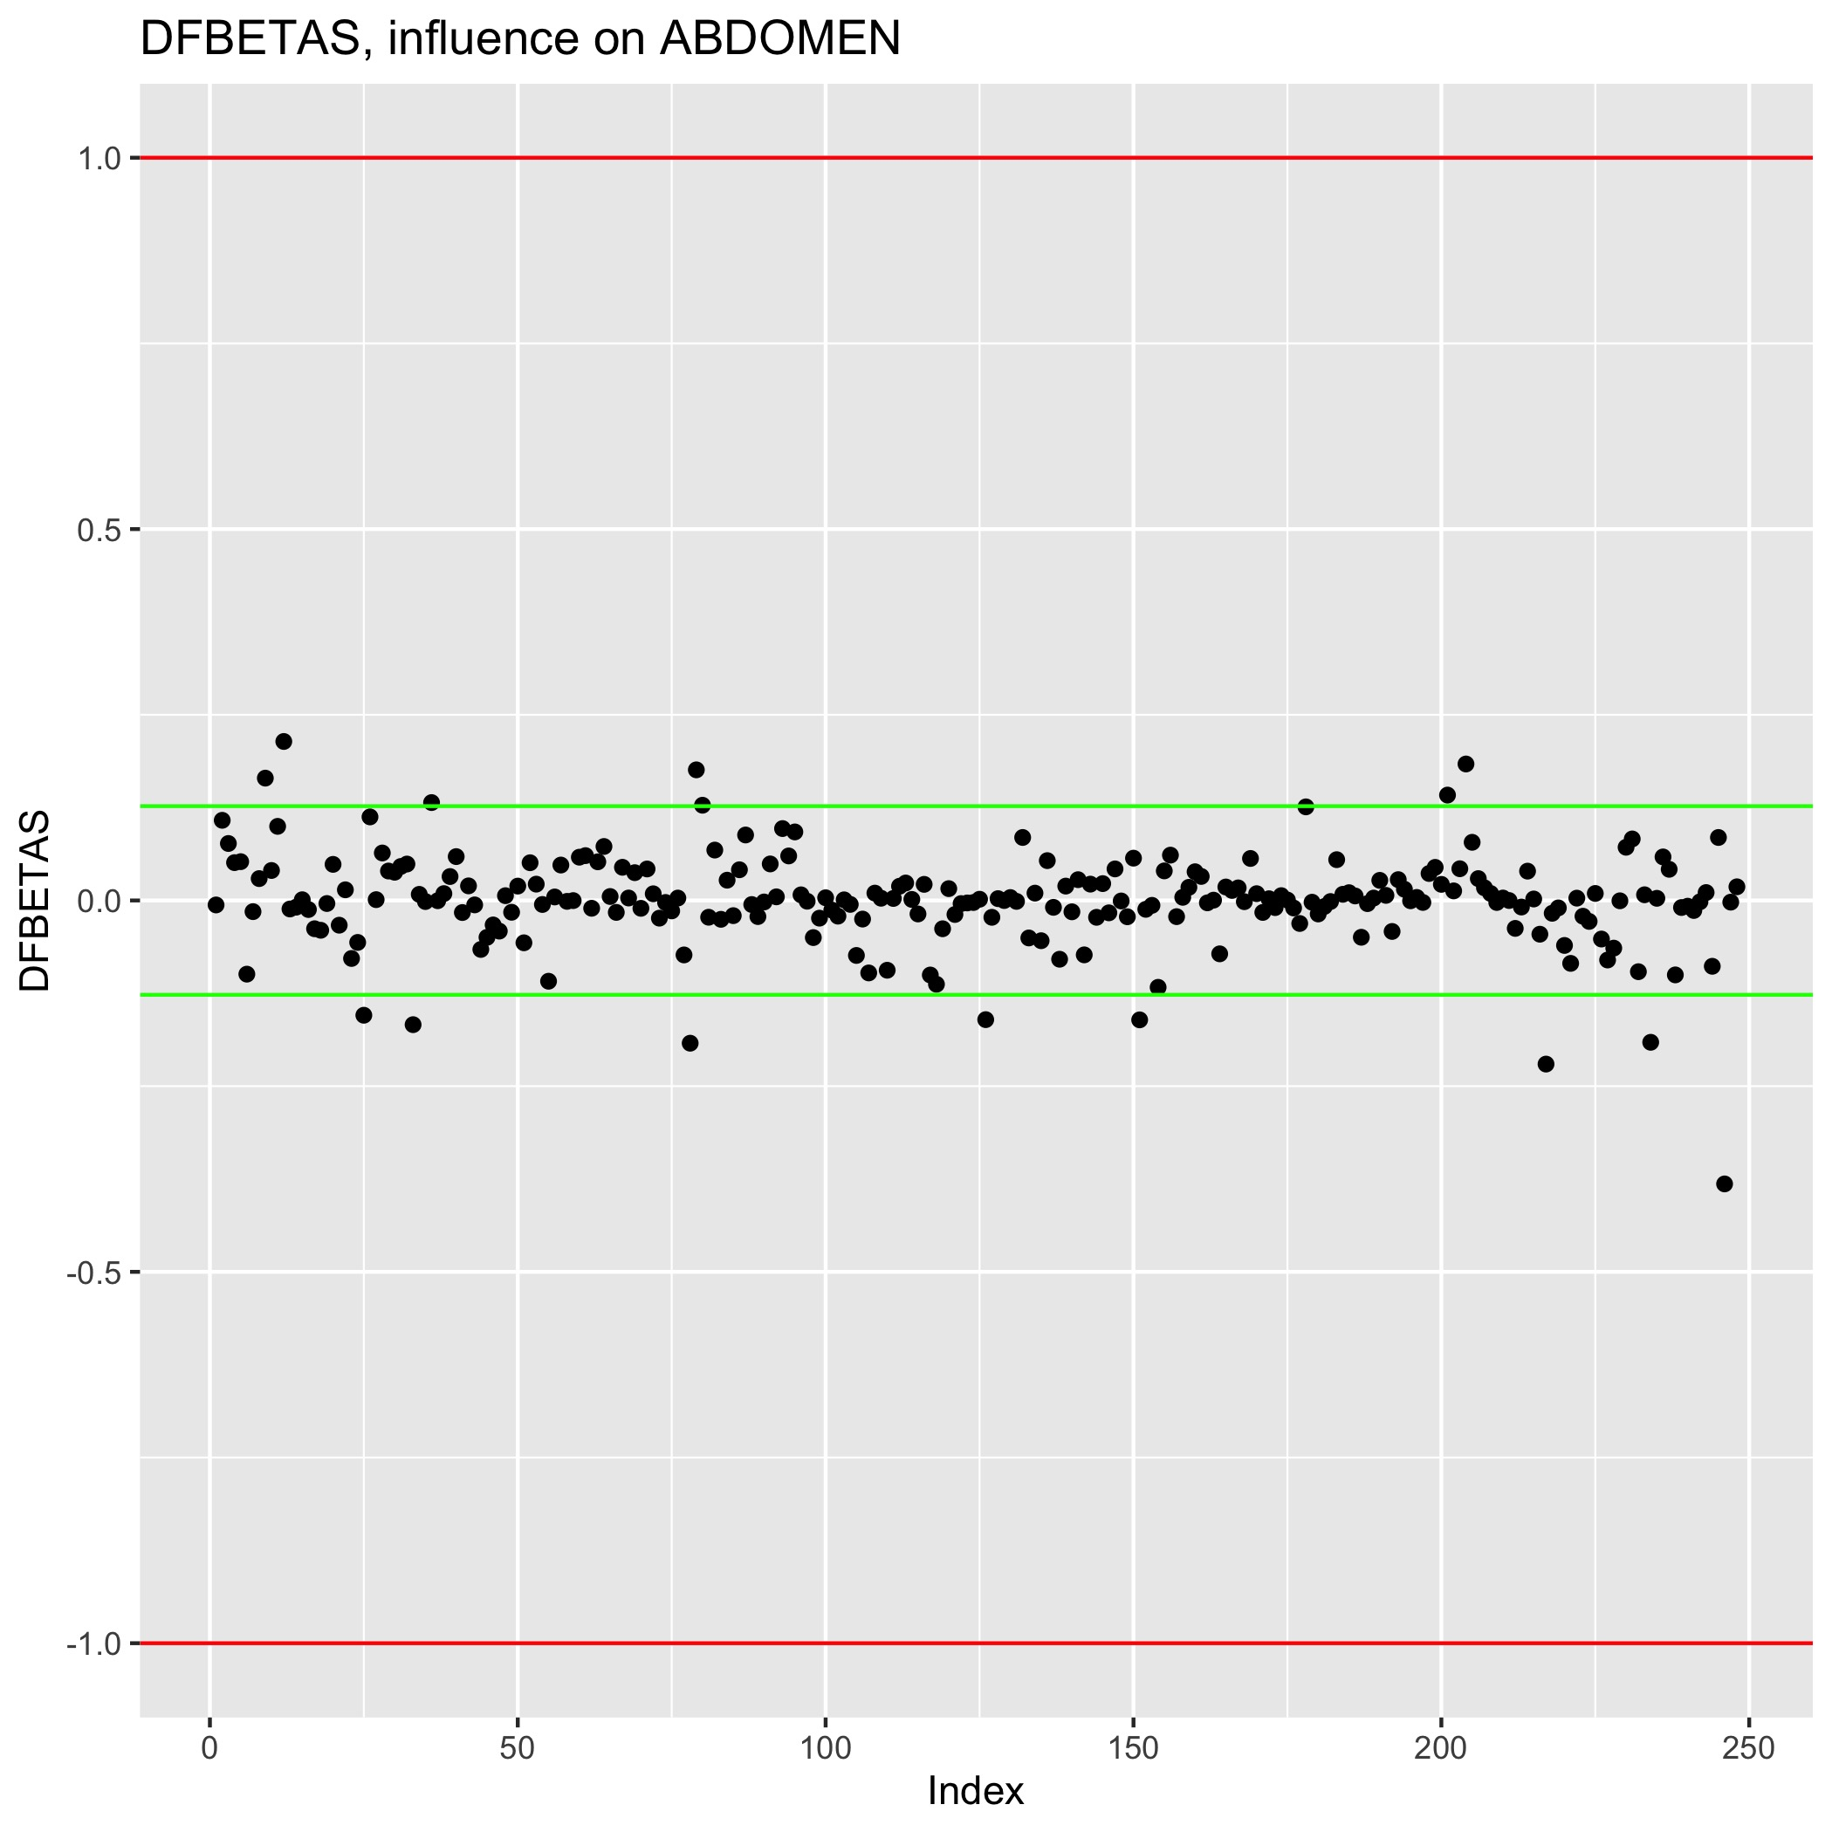
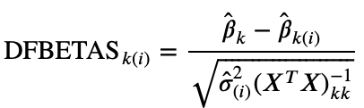
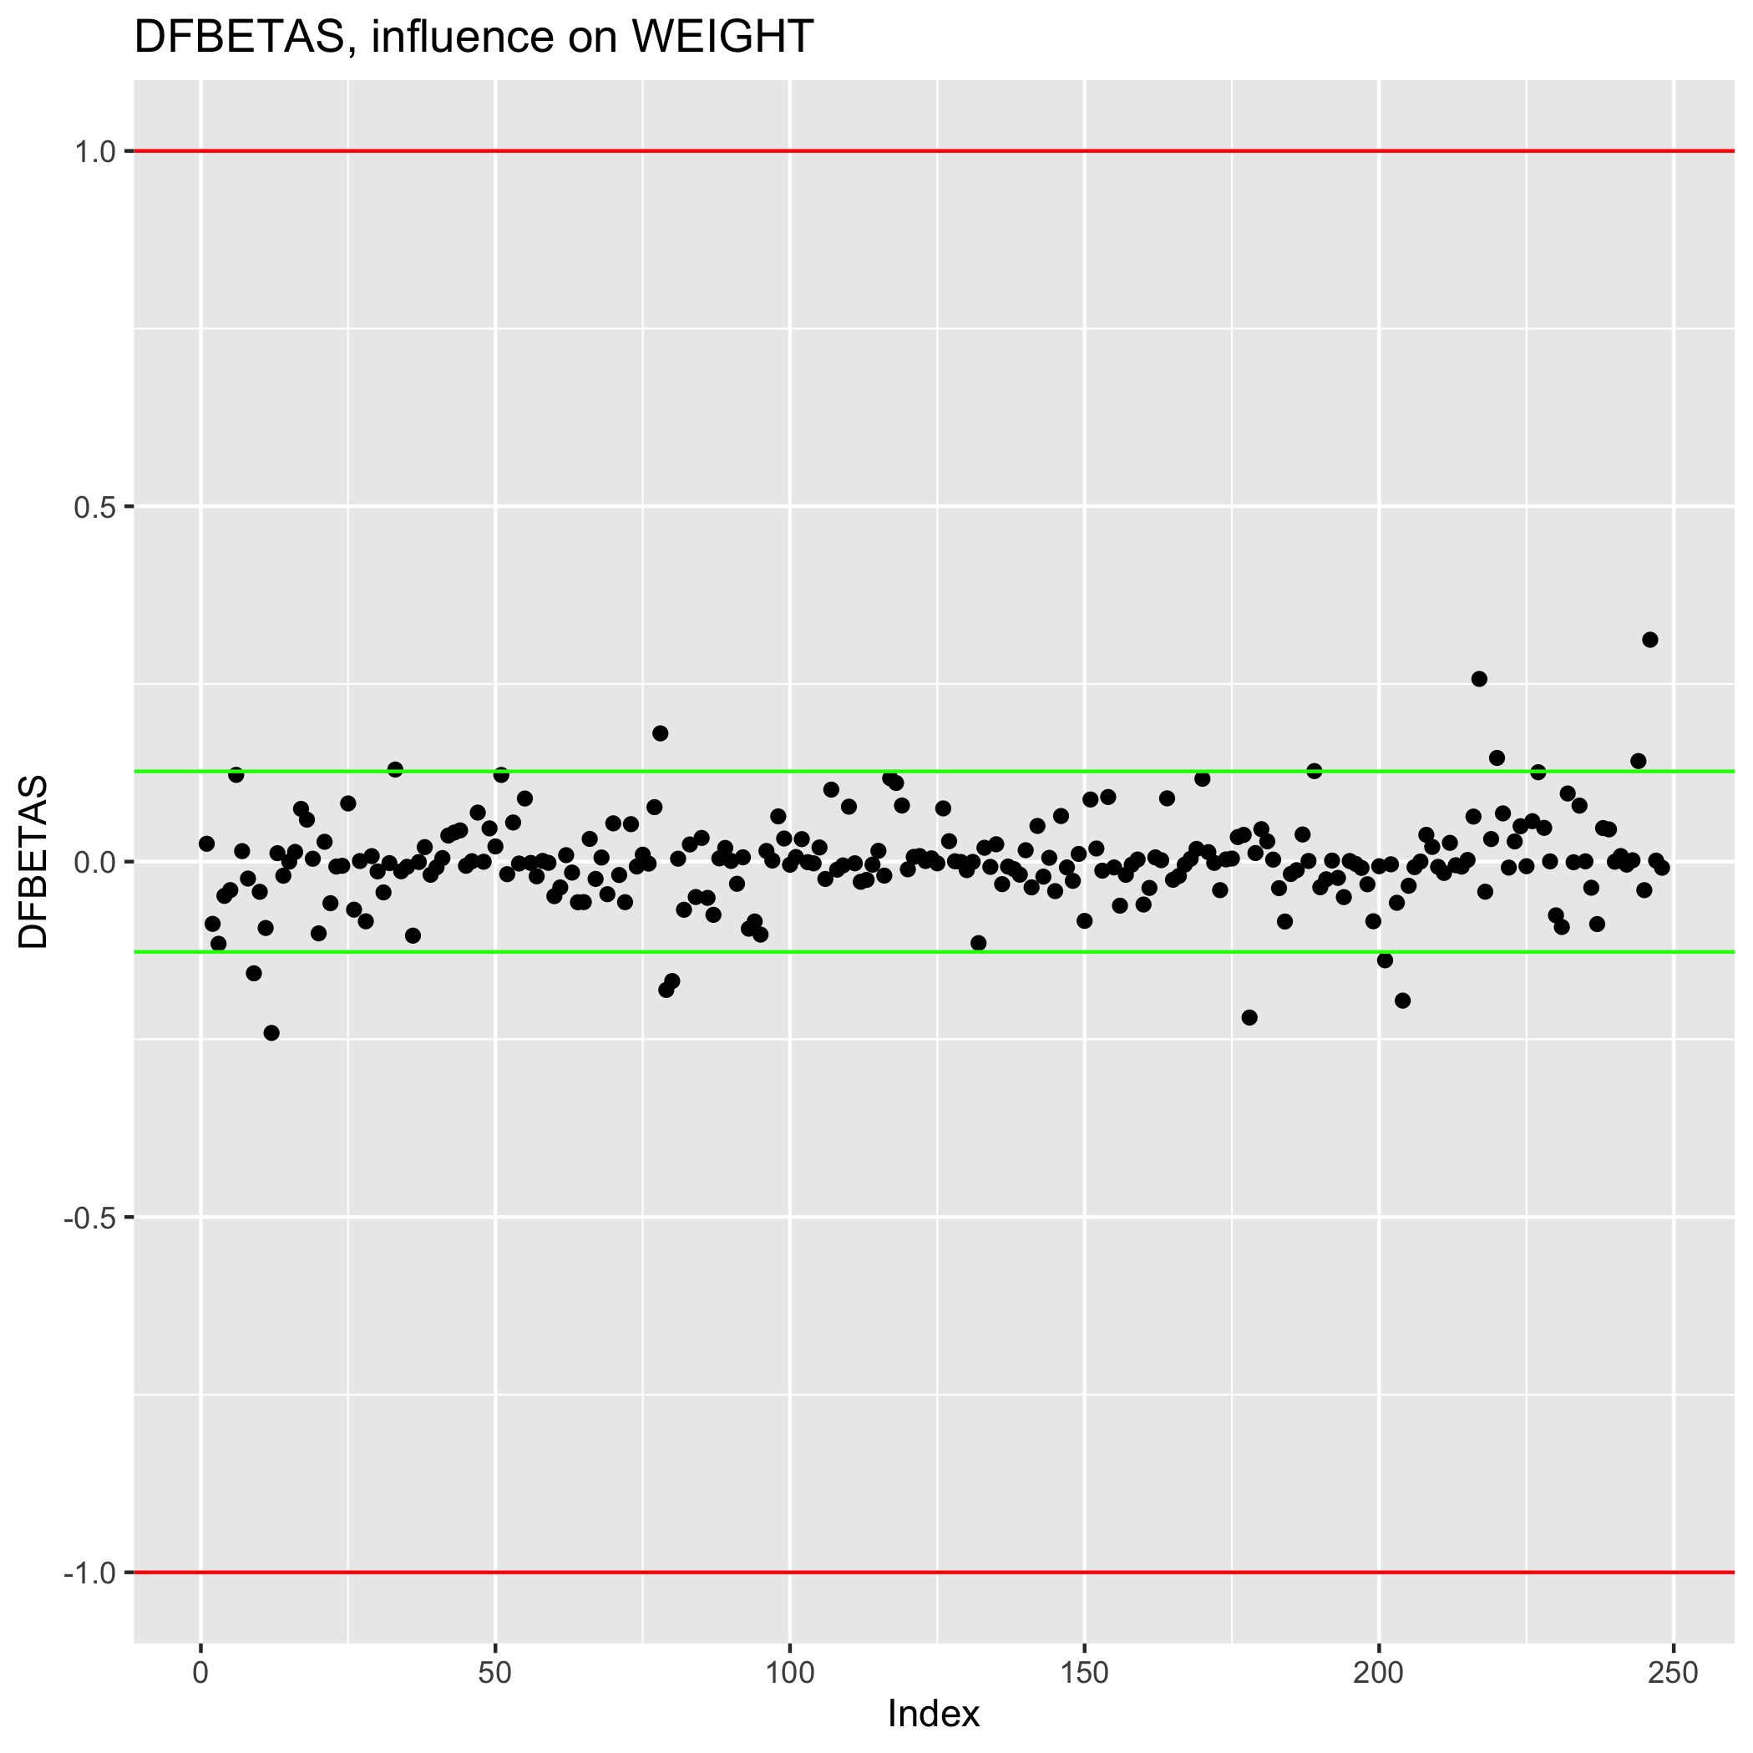
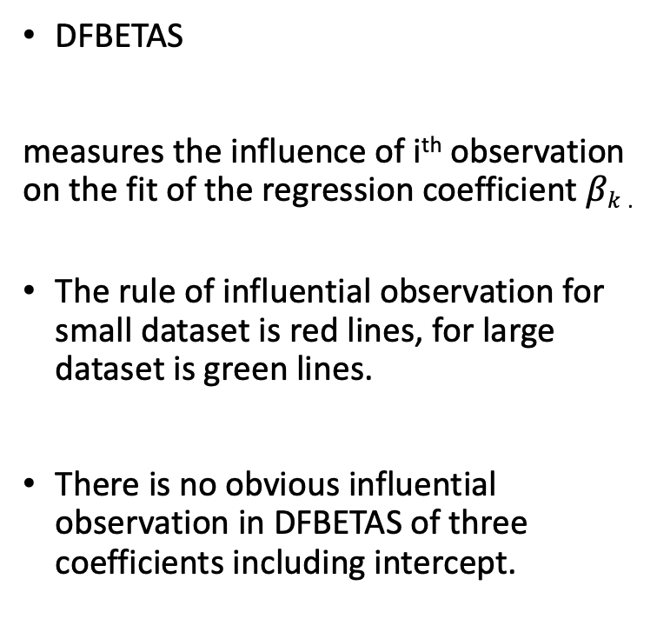
Model Diagnosis - DFBETAS
DFBETAS
measures the influence of i^{th} observation on the fit of the regression coefficient $βk$ .
The rule of influential observation for small dataset is red lines, for large dataset is green lines.
There is no obvious influential observation in DFBETAS of three coefficients including intercept.

Slide 22
Model Diagnosis and Summary
Advantages:
Perform well in diagnosis.
No serious multicollinearity.
All linear regression assumptions hold.
Disadvantages:
The R-squared is not perfect.
Improvement:
We expect large and detailed data sets.
Is there any improvement for new variables from complex transformation and combination?

Slide 23
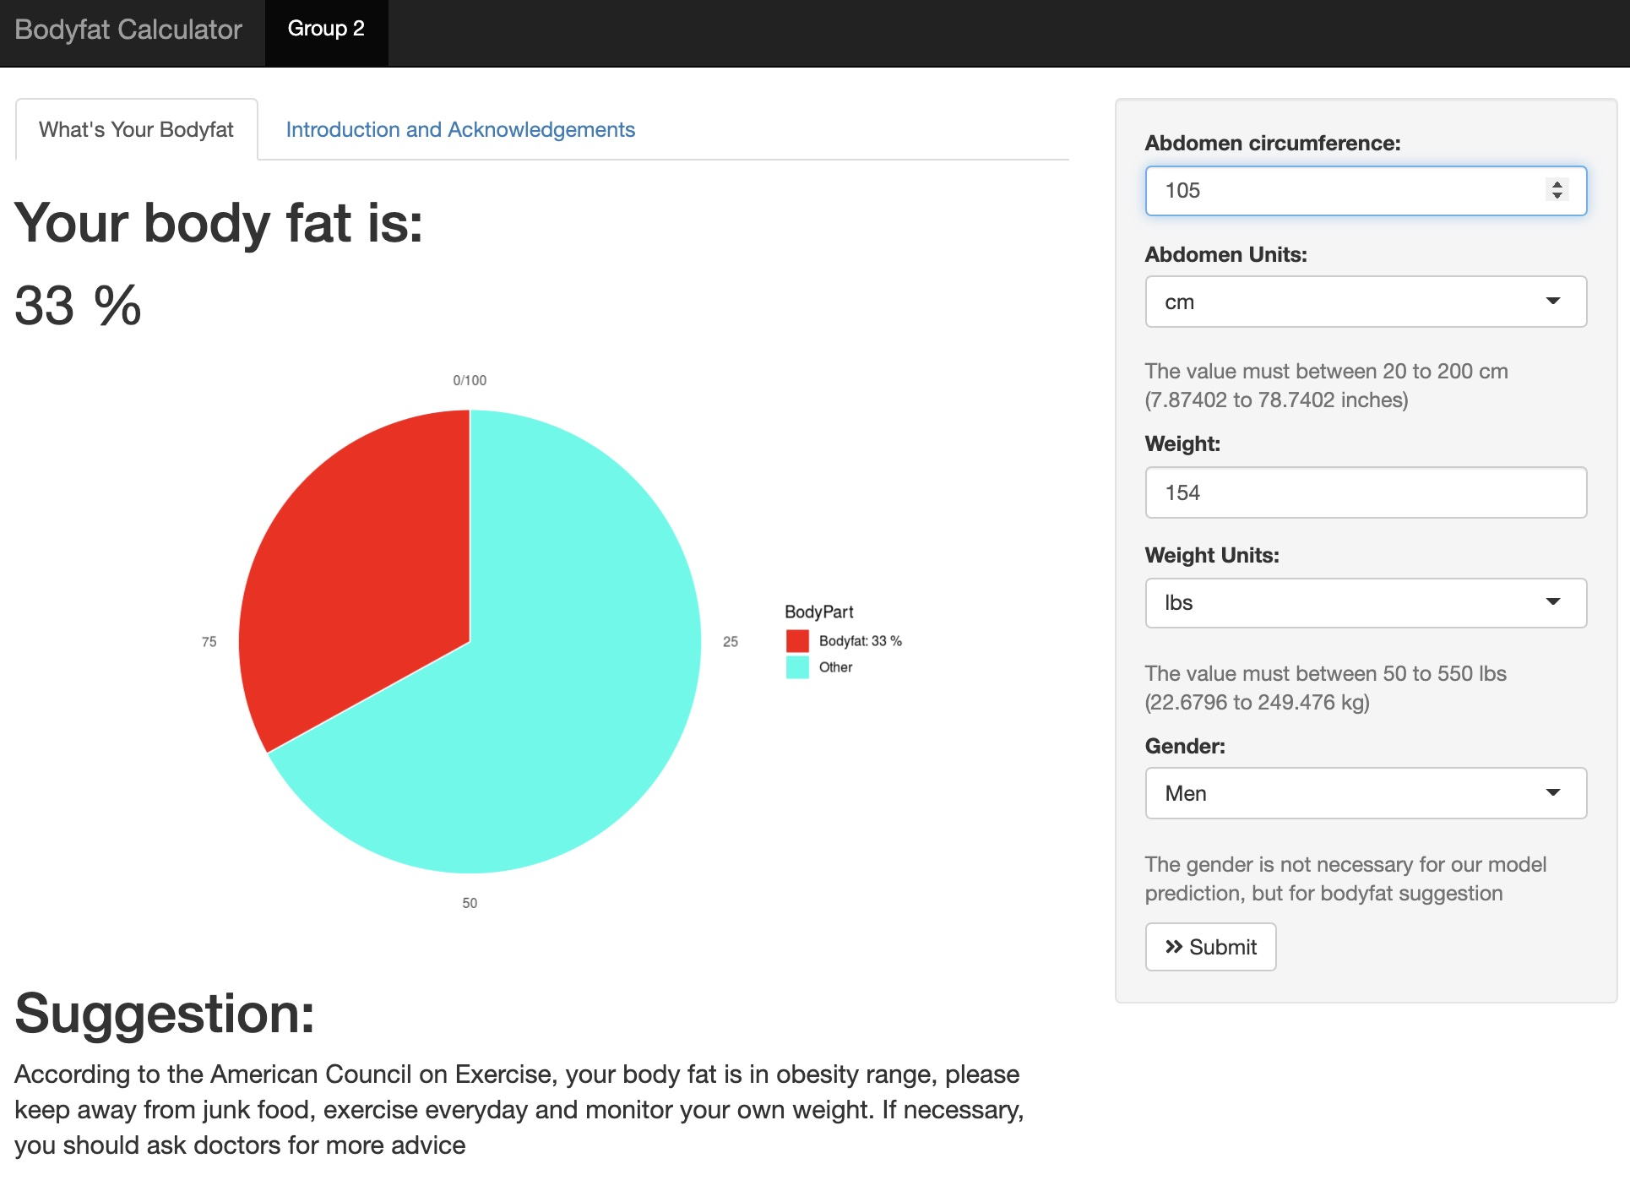
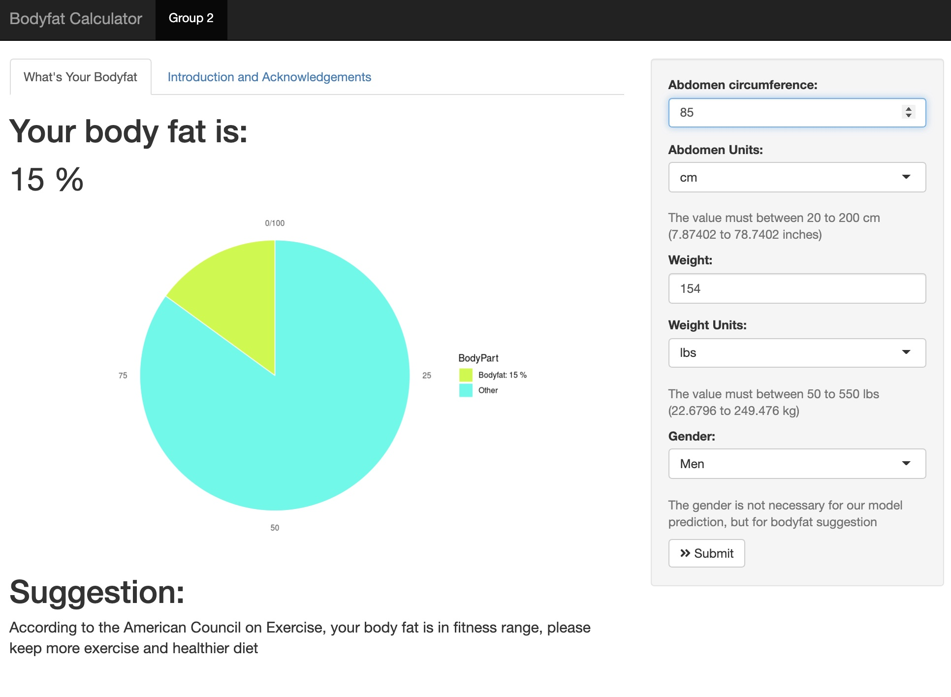
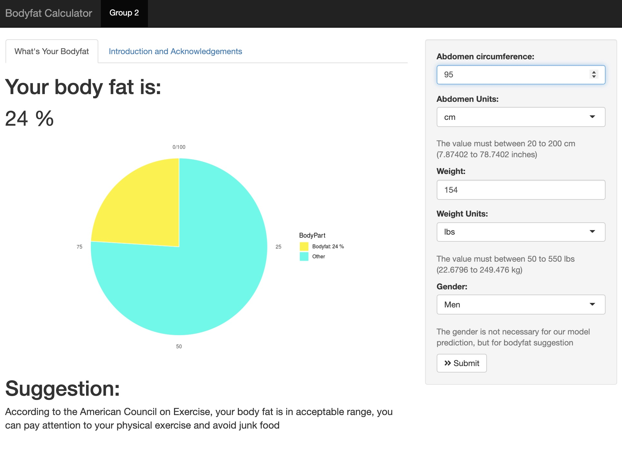
Shiny Application
Unit change in metric and English.
Color warning when your bodyfat is high.
Body fat suggestion from American Council on Exercise

Slide 24
Acknowledge
GitHub, Main Code
Main code edited by CHENYANG JIANG and ENZE WANG
PCA edited by HanGyu KANG
Model selection fixed by RUI HUANG
GitHub maintained by ENZE WANG
Shiny App
Main edited by RUI HUANG and HanGyu KANG
The interface, ggplot and unit part are fixed, edited and maintained by ENZE WANG
Other problems are fixed by CHENYANG JIANG
Presentation
PPT edited by ENZE WANG
Video edited by HanGyu KANG
Presented with CHENYANG JIANG and RUI HUANG
PDF Summary
Main edited by ENZE WANG
Fixed by RUI HUANG, CHENYANG JIANG and HanGyu KANG

